Slide 1
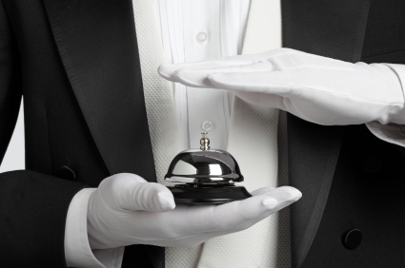
PROVIDE VALET SERVICES TO GUESTS
Unit Code: D1.HHK.CL3.06
Notes:
Trainer welcomes trainees to class.

Slide 2
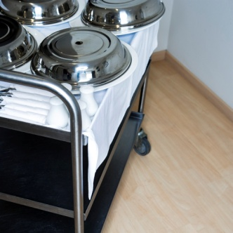
Provide valet services to guests
This unit comprises four Elements:
Identify the role of a valet
Prepare to deliver valet services
Deliver valet services
Record valet services.
Notes:
Trainer advises trainees this Unit comprises four Elements, as listed on the slide explaining:
• Each Element comprises a number of Performance Criteria which will be identified throughout the class and explained in detail
• Trainees can obtain more detail from their Trainee Manual
• At times the course presents advice and information about various protocols but where their workplace requirements differ to what is presented, the workplace practices and standards, as well as policies and procedures must be observed.

Slide 3

Assessment
Assessment for this unit may include:
Oral questions
Written questions
Work projects
Workplace observation of practical skills
Practical exercises
Formal report from employer/supervisor.
Notes:
Trainer advises trainees that assessment for this Unit may take several forms all of which are aimed at verifying they have achieved competency for the Unit as required.
Trainer indicates to trainees the methods of assessment that will be applied to them for this Unit.

Slide 4
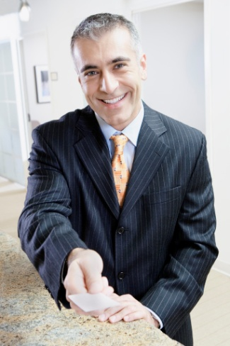
Identify the role of a valet
Performance Criteria for this Element are:
Describe the services delivered by a valet
Locate the position of valet within the enterprise
Identify the personal characteristics
required of a valet
(Continued)
Notes:
Trainer identifies for trainees the Performance Criteria for this Element, as listed on the slide.

Slide 5
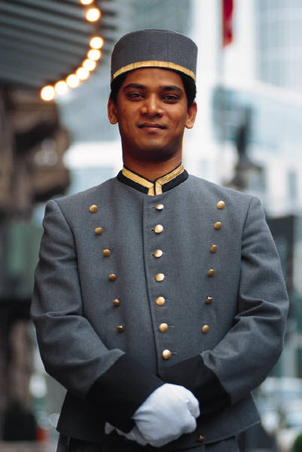
Identify the role of a valet
Describe grooming & personal presentation standards for a valet
Interpret enterprise policies & procedures for the provision of valet services
Identify & explain the role of
communication in valet service
provision.
Notes:
Trainer continues to identify for trainees the Performance Criteria for this Element, as listed on the slide.
Class Activity – General Discussion
Trainer leads a general class discussion on the role of the valet by asking questions such as:
Who has had experience as a valet and what was your experience? What did you do?
What services do valets provide for their guests?
Where does the job of valet fit into the overall structure of a venue?
What personal characteristics are required of a valet?
What grooming and personal presentation standards apply to the job of valet?
What venue policies and procedures apply to the delivery of valet services to guests?
How important is communication in the relationship between guest and valet, and why?

Slide 6
Describe the services delivered by a valet
Applies to all establishments where specialist valet or butler services are conducted
Valet = Butler (Manservant, or a Gentleman’s gentleman’)
Not a common service
Adds style and class
May be provided free – or
may need to be paid for.
Notes:
Trainer explains basic background information to trainees about this unit and valets:
The unit applies to all establishments where specialist valet or butler services are conducted – hotels, serviced apartments
Valet is also known by some as a ‘butler’. In older times they were also called ‘Manservants’ and/or ‘Gentleman’s gentlemen’. Women today also provide valet services
Not every venue will offer valet services – usually higher class/5-star venues. Many overseas guests expect valet service especially where they use them regularly in other (or home) countries
Use of valets not only provides genuine services to guests buy also adds and infers class, style, elegance, indulgence and wealth
Valet services may be paid for by the guest on an hourly or daily basis or they may be provided to VIP guests (and/or high rollers in casinos on a ‘complimentary’ (free of charge) basis).

Slide 7

Describe the services delivered by a valet
Valet roles:
Housekeeper
Confidant
Guide
Concierge
(Continued)
Notes:
Trainer explains to trainees that many regard the valet as providing a combination of roles each with its own demanding level of personalised and individualised services, indicating the various roles include:
Housekeeper – performing a range of services normally provided by room attendants in other rooms
Confidant – being a trusted person who the guest can confide in when they need to talk or share an idea, experience or opinion
Guide – informing the guest of what is available both within and outside the venue, when it is available, how to get there and how to obtain entry, tickets, preferential treatment
Concierge – while all valets work together with the concierge in a venue, many valets often take the role of concierge for the guest/s they are looking after.

Slide 8
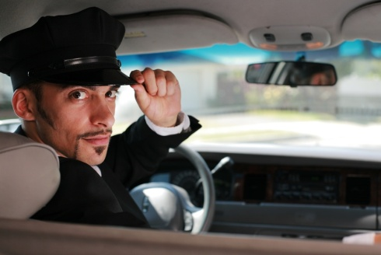
Describe the services delivered by a valet
Organiser
Supervisor
Guest relations.
Valets & guests have a special relationship due
to the nature of the relationship
Notes:
Trainer continues to indicate to trainees the various roles a valet needs to perform:
Organiser – arranging things (reservations, tickets to shows, entry to events, meetings with people, daily schedules) on behalf of and under the direction of the guest
Supervisor – overseeing the work of other people (venue employees and outside contractors/workers) who provide products and services to the guest
Guest relations – ensuring the guest has a pleasant stay in the venue, ensuring their expectations are met and dealing with any problems that arise during the stay.
Trainer highlights to trainees there is a special relationship between valet and guest characterised by a close working relationship and insight into personal affairs.

Slide 9
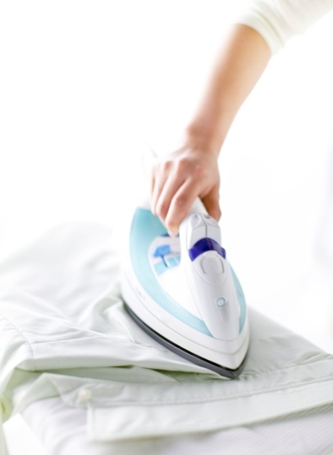
Describe the services delivered by a valet
Valet duties can include:
Communicating with guests & their party
Unpacking & storing guest luggage
Preparing clothes & footwear
Ironing of items
(Continued)
Notes:
Trainer identifies for trainees the main duties of a valet mentioning their workplace Job/Position Description is a good starting point for determining what is expected:
Professionally and confidentially communicating – with the guest, and on behalf of the guest and their party (spouse, manager, agent, retinue, personal assistants)
Unpacking and storing guest luggage – according to instructions and/or using common sense (more on this later)
Preparing guest clothes and footwear – ready for use, including laying out clothes
Light pressing of garments – as required or requested.
Class Activity – Handouts
Trainer obtains one or more Job Descriptions/PDs for valets from local venues and:
Distributes and discusses same with trainees
Highlights aspects of the documents of obvious importance to management.

Slide 10

Describe the services delivered by a valet
Packing guest luggage
Cleaning & polishing shoes
Repairing clothes & other items
Providing assistance in relation to organisation of guest needs & requests
(Continued)
Notes:
Trainer continues identifying for trainees the duties of a valet:
Packing guest luggage for their departure
Cleaning and polishing shoes as required or requested
Repairing, or organising the repair of, clothes and other guest belongings
Providing assistance in relation to organisation of guest needs and requests for things such as wake up calls, newspaper, coffee/tea. The list here is really endless.

Slide 11
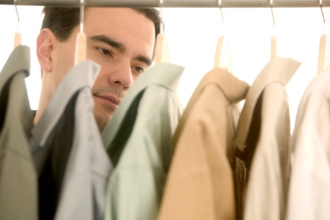
Describe the services delivered by a valet
Monitoring provision of services to the guest
Recording services delivered
Preparing room(s) before guest arrives
Looking after guest laundry & dry cleaning needs
(Continued)
Notes:
Trainer continues identifying for trainees the duties of a valet:
Monitoring the provision of establishment services to the guest both in-room and throughout the venue. This may include:
Arranging and supervising the provision (delivery and service) of room service for meals, snacks, parties, drinks
Organisation and implementation of functions for the guest in their room or in a function room at the venue
Recording services that have been delivered for quality control and accounting procedures
Preparing room(s) before guest arrive by providing various items such as fruit bowls, complimentary gifts, bathrobes, chocolates or flowers
Looking after guest laundry and dry cleaning needs on an ongoing basis for the duration of their stay

Slide 12
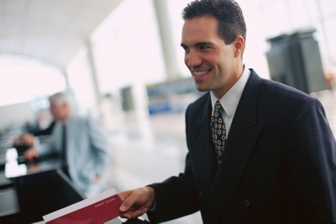
Describe the services delivered by a valet
Organising & processing secretarial duties on request
Arranging bookings & making purchases
Organising activities to meet guest needs
Providing of local advice
Dealing with travel arrangements.
Notes:
Trainer continues identifying for trainees the duties of a valet:
Organising and processing secretarial duties upon request such as messages, faxes, packages, translation, postage, and use of the business facilities at the property
Arranging (sometimes via the concierge) restaurant bookings, car hire, tours, specified purchases of gifts or other items
Organising activities to meet guest needs such as arranging special functions in the venue or room, booking local excursions and tours, and making reservations for the theatre, shows, dining and special events
Provision of local advice (the ‘concierge’ function) including:
Recommendations for dining and shopping
Suggestions for transport and sightseeing
Options for tourism and leisure activities
Acquisition of personal services.
Making, altering and/or confirming travel arrangements – obtaining tickets, obtaining quotations.

Slide 13
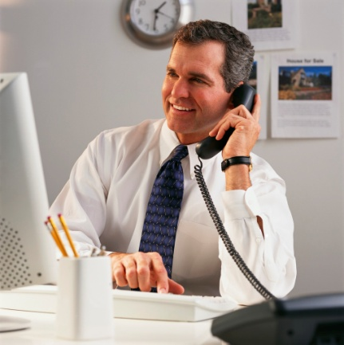
Describe the services delivered by a valet
Before guest arrives:
Research the guest
Identify their needs, wants & preferences
Take action to meet expectations.
Notes:
Trainer continues identifying for trainees the duties of a valet explaining prior to guest arrival that the valet must:
Investigate background information and knowledge about guest preferences and previous history with the establishment
Take action to ensure promises made to the guest – and guest expectations – are met when the guest arrives.
Trainer explains these areas will be covered in more detail on later slides.

Slide 14
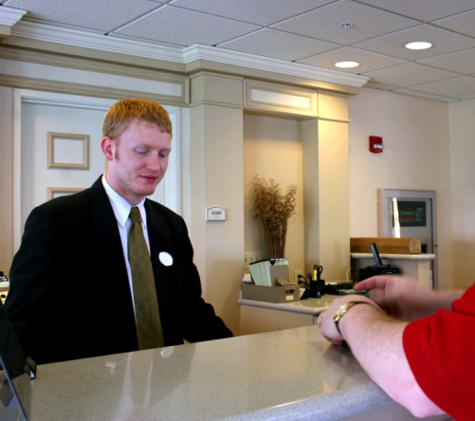
Describe the services delivered by a valet
On departure:
Process charges to guest account
Update guest history
De-brief with management.
Notes:
Trainer continues identifying for trainees the duties of a valet explaining before and on departure of a valet-serviced guest that the valet must:
Record and process guest charges and accounts for billing and payment
Assist in the maintenance of guest history file(s) to provide relevant and up-to-date information about the guest/VIP.
De-brief with management to identify lessons learned, determine changes needing to be made to SOPs and whether or not management needs to contact the guest to make an apology.
Trainer again explains these areas will be covered in more detail on later sides.
Class Activity – Guest Speaker
Trainer arranges for a guest who uses valet services in a venue to attend and:
Identify their expectations regarding valet services
Explain the tasks they have used valets for
Talk about the annoying activities or habits of valets
Discuss their experiences (good and bad) with valets
Provide their tips and advice about what valets should and should not do when servicing guests.

Slide 15
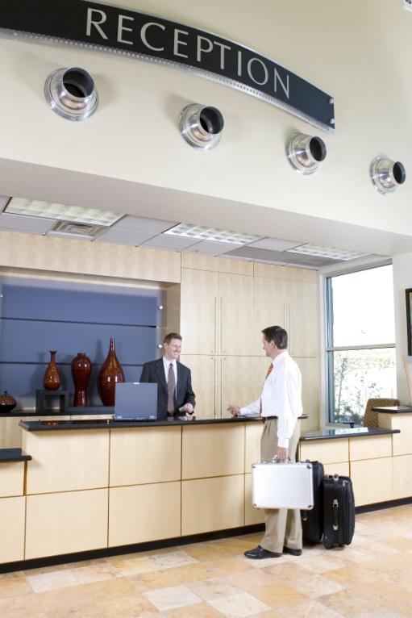
Locate the position of valet within the enterprise
The position of valet varies between properties:
They are front-of-house staff
They are guest contact staff
They are service providers.
Businesswomen may request a
female valet.
Notes:
Trainer discusses the location of the position of valet within a venue stating:
It varies between properties. Most locate it within Housekeeping (some do not) reporting to the Executive Housekeeper/Manager – Rooms
They are a front-of-house member of staff. They are not ‘back of house’ staff who work ‘behind the scenes’
They are a guest contact staff member as opposed to a management or administration
They are a service provider. While they perform some liaison and supervision duties their primary role is one of service provision.
Many businesswomen who travel on a regular basis will request a female valet as they feel more comfortable working with another female, and also feel it is more appropriate than working closely and privately with an unknown male

Slide 16

Locate the position of valet within the enterprise
Interactions the valet may have include:
Liaise with Sales & Marketing
Liaise with Front Office & Concierge
Liaise with Food & Beverage, Kitchen & Function/Banquet departments
Be involved in middle-level
management meetings.
Notes:
Trainer indicates the interactions in the workplace a valet may have indicating the valet may:
Liaise with Sales and Marketing cocerning VIP guests arriving, and to advise them of needs, wants and preferences of VIPs
Liaise with Front Office and Concierge to deliver products and services as required by the guest/s
Liaise with Food and Beverage, Kitchen and Function/Banquet departments to ensure special food, drink, catering and event needs are provided for
Be involved in middle-level management meetings to:
Enable the identified needs, wants and preferences of VIP guests to be met
Discuss and initiate required security protocols for certain guests
Facilitate venue-wide organisational and operational arrangements to support a VIP stay.
Class Activity – Guest Speaker
Trainer arranges for a venue Manager to attend and talk to trainees about:
The role of valet
Duties of a valet
Their expectations about the work of a valet
Guests who use valet services
Anecdotes involving valets
House rules regarding what valets can and cannot do, including their scope of authority
Venue policies and procedures applying to valets/with which valets must comply
Training of valets in-house
Charges made for use of valets by guests.

Slide 17
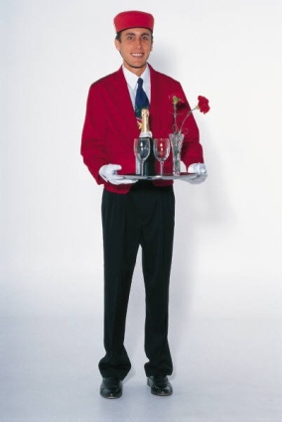
Locate the position of valet within the enterprise
Valet employment options include:
Full-time
Part-time
Casual
Outsourced.
Notes:
Trainer presents to trainees possible employment options for valets in venues:
Full-time valet. This is not common except at 5-star and 6-star facilities because generally speaking there is insufficient work to warrant their employment on a permanent ongoing basis
Part-time valet – this is relatively common. The person works as a valet when required, and performs another role such as Room Service attendant, Porter or Laundry attendant within the venue when there is no demand for a valet. Wages per hour are usually higher for a valet than for other lower-level duties
Casual – the venue hires valets as required, paying them on an hourly basis, choosing employees from a known pool of professionals
Outsourcing – where the services of an external provider specialising in the provision of hospitality professionals is used. This option is gaining in popularity amongst employers where such a service is locally available.

Slide 18
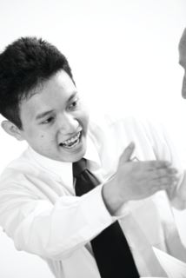
Identify the personal characteristics required of a valet
Valets must have high-level working skills, plus:
Tact & diplomacy
Discretion
Etiquette
(Continued)
Notes:
Trainer explains to trainees the work performed by a valet requires them to possess high-level technical/operational skills and a unique set of personal characteristics such as:
Tact and diplomacy
Tact may be seen as the ability to know when to say something and when not to say something. It also means being able to say what needs to be said without giving offence, without making people feel uncomfortable or ignorant.
Diplomacy is the skill of applying tact to situations so the outcome is beneficial to the valet and their guest. The two terms ‘tact’ and ‘diplomacy’ are commonly used together.
A person who is effective with tact is said to be ‘tactful’.
A person who applies tact very well is regarded as being ‘diplomatic’.
Discretion
Exercising discretion means being discrete. In practice this means demonstrating the ability to judge when to ignore something the guest may have said or done – or forgot to say or do.
Central to being discrete is:
The action of ‘turning a blind eye’
Not mentioning the event to the guest or to anyone else.
Etiquette
Etiquette refers to knowledge about social convention across a range of issues such as:
The different forms of address to be used when talking to dignitaries
The correct piece of cutlery to use when setting a table for a meal
Action to take to make others feel ‘at ease’.
Etiquette can be described as good manners, decorum and propriety. It is the set of customary rules for behaviour in polite society.

Slide 19

Identify the personal characteristics required of a valet
Good manners
Politeness
Civility
(Continued)
Notes:
Trainer continues to present to trainees the personal characteristics required by a valet:
Good manners
Good manners and etiquette go together but they are not the same thing. Manners relates to:
Showing respect for others
Demonstrating politeness
Being refined and appropriate in all situations
In practice it means:
Knowing when to talk and when to be quiet
Giving way to guests
Remaining a respectful distance from guests in terms of physical distance and personal connection.
Politeness
Being polite means applying necessary etiquette and good manners. It is closely aligned with showing respect, making people feel at ease and creating an appropriate and refined atmosphere for the guest and their associates
In practice it means:
Asking for permission to undertake tasks
Saying ‘please’ and ‘thank you’
Knowing when to withdraw and leave guests alone and when to maintain a presence.
Civility
Civility means acting in a civil manner
Civility is closely linked to manners and means avoiding anything that could be construed as rude, disrespectful or intended to give distress or cause offence
It may embrace adhering to a ‘Code of Conduct’ imposed by the venue in regard to treatment of guests and others.

Slide 20
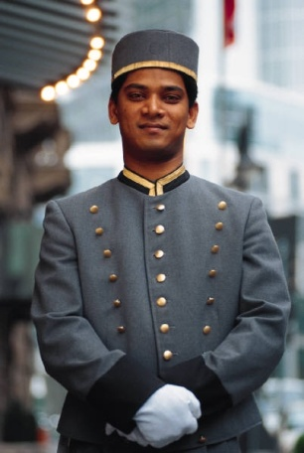
Identify the personal characteristics required of a valet
Honesty
Dedication
Willingness to be of genuine service
(Continued)
Notes:
Trainer continues to present to trainees the personal characteristics required by a valet:
Honesty
This is a basic requirement for all staff
Later slides will provide more information on ‘honesty’ as it applies to valets.
Dedication
Dedication means being committed to your job and the guests and showing enthusiasm about what needs to be done.
As a valet trainees may sometimes find themselves in a position where being dedicated to a guest means they cannot be dedicated to what the venue requires them to do. These situations require them to use personal judgement about what to do. When making a decision about who or what takes priority in these situations, they should consider the following:
Always use common sense to assist in deciding what to do
Never do anything that is illegal or which places you in danger
Be prepared (if time allows) to seek guidance and counsel from more experienced and senior staff.
Willingness to be of genuine service
All venue staff should be willing to provide genuine service to all guests but nowhere is this more important than with valets.
Demonstrating willingness to be of genuine service means not only ‘doing the right thing’ but doing it with the right attitude. For a valet, a willingness to be of genuine service is critical because:
They spend comparatively more time with guests than any other staff member. Valets are with their guests on a day-to-day basis and sometimes for many hours at a time
Guests rely on valets to a greater extent than they rely on all/most other staff. Valets are expected to undertake many duties on behalf of the guest that reflect the guest’s standing, image and reputation
Guests may pay a premium to have the services of a valet. Generally speaking valets must be paid for by the guest on an hourly, or ‘per stay’, basis so guests are entitled to expect them to be genuinely committed to excellent levels of service delivery. Very often, this means being prepared to do ‘a little bit extra’ to please or satisfy the guest.

Slide 21
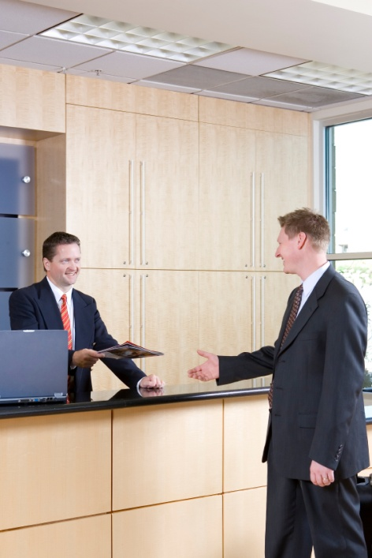
Identify the personal characteristics required of a valet
An unbiased, prejudice free disposition
Punctuality
Attention to detail
Initiative.
Notes:
Trainer continues to present to trainees the personal characteristics required by a valet:
An unbiased and prejudice free disposition
All valets must be free of bias and refrain from judging their guests because:
They will have to deal with from a wide range of cultures, ethnic backgrounds, and ages
They will experience a great variation in the personal habits of guests, individual opinions and thoughts of guests and in the manners, attitudes and beliefs of guests.
All of these characteristics will give rise to differences in the way guests behave, conduct themselves, talk to and treat people. The role of the valet is not to judge the guest based on these individual differences but simply to continue serving them
The important thing to remember when a guest holds a different opinion, attitude or stance to personal opinions is that there is no requirement to agree with them, and no need to adopt them as a personal orientation: just serve the guest.
Punctuality
All valets must be highly aware of the need for them to be punctual. In practice this means:
Arriving for work early to ensure all the requirements for the day have been arranged
Not leaving work until the needs of the guest have been taken care of. A valet can never work hours totally governed by a roster. You must stay as long as the guest needs you, or arrange for another valet to replace you
Making sure all arrangements made for or on behalf of the guest are delivered punctually. This applies to ensuring in-house services are delivered when promised as well as following up with external service providers to make sure what they have promised arrives when promised and on time.
Attention to detail
The valet must have an eye for detail and take necessary action to make sure everything done for, or provided to, the guest is the best it can be. The fact of life for a valet is that little things do count and it is often the little things that make the big difference for a guest. Definitely, for a valet, ‘near enough is never good enough’.
Keys to making sure every detail is correct are:
Planning and preparation – deciding in advance what needs to be done, what needs to be present and how things must look, flow and/or occur
Observation – physically paying attention (by looking, listening and smelling) to determine whether or not things are correct or whether some details requires attention.
Many expert valets develop what may be regarded as a sixth sense – being able to intuitively understand or predict what their guest needs will be even before the guest realises them.
Taking action when a detail is identified as missing, or in some way incorrect. Valets must always take action when there is a need to do so.
Initiative
Perhaps the greatest personal characteristic a valet can have is the ability to use their initiative to best serve their guest. Some people are born with initiative and some learn it on-the-job through ongoing contact with guests. This guest contact teaches them what to expect and gives them insight into how individuals can vary and how these variations translate into necessary and/or appropriate service delivery.
Initiative requires anticipation of what the guest will do or may need followed by the taking of action to ensure these needs are met
When unsure about what a guest wants, needs or prefers the recommended advice is to ask the guest what they want.

Slide 22

Describe grooming & personal presentation standards for a valet
Strict standards must be observed in relation to:
Wearing the uniform, ensuring:
It fits properly
It is clean
It is in good condition.
Notes:
Trainer identifies to trainees that there are strict requirements relating to the grooming and personal presentation standards for valets. They need to be aware of issues relating to:
Wearing the uniform
Important aspects are to ensure:
It fits properly so it looks good, enables freedom of movement and is comfortable to wear
It is kept clean. It is a standard requirement for all valets is to have at least one change of clothes available to them at work so uniforms can be changed when they get dirty or look ‘tired’. The uniform must aways be:
Pressed – meaning it must be free of wrinkles and look cared for
Stain-free and free of marks, dirt or other mess
It remains in good repair – there can be no loose threads and no missing buttons.

Slide 23
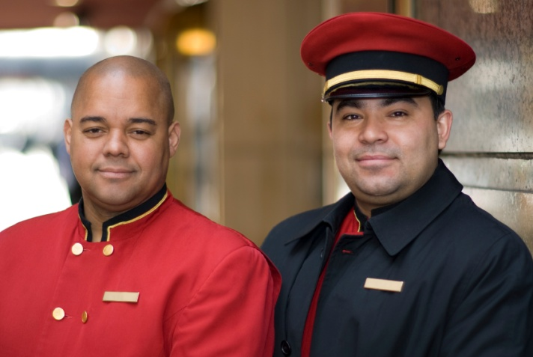
Describe grooming & personal presentation standards for a valet
Your uniform must comply with venue requirements which can relate to:
Type & style of shoes
Name tag
Type of jacket or suit
Epaulettes
Tie.
ALL the uniform must be worn.
Notes:
Trainer stresses to trainees they must also:
Comply with specific venue requirements for valet uniforms which may refer to:
Type and style of shoes to be worn such as black, polished leather shoes
Whether or not a name tag is worn. Most valets do not wear a name tag as this is seen as detracting from and/or demeaning the position of valet
The uniform itself. For example, many valets are required to wear a designated style (lounge or dinner suit; two or three piece) and colour (black or grey) of suit as opposed to wearing traditional industry ‘black and whites’
Epaulettes. Where a jacket is worn by a valet they commonly wear a different colour or style of epaulette to distinguish them from other service staff
Tie – stipulating colour and type of knot to be used (for example, Windsor knot, half-Windsor).

Slide 24
Describe grooming & personal presentation standards for a valet
Basic grooming requirements include:
Regular washing/bathing
Use of a suitable deodorant
Use of lightly scented perfumes or
after-shave lotion
(Continued)
Notes:
Trainer advises trainees about grooming stating their grooming activities ensure their personal presentation and hygiene, and standard grooming activities to be considered or applied may include:
Regular washing/bathing – a minimum is once per day but many valets will bathe twice daily
Use of a suitable deodorant to help prevent perspiration
Use of lightly-scented aftershave or perfume – strong perfume which is predominant or over-powering must be avoided

Slide 25
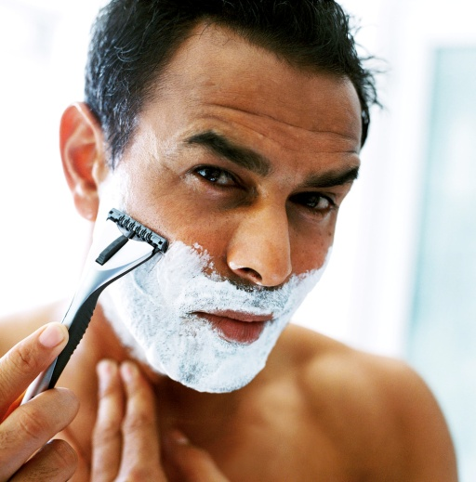
Describe grooming & personal presentation standards for a valet
Use of neutral make-up for women
Good personal hygiene habits & practices
Men must be clean shaven
Hair must be neat & tidy
(Continued)
Notes:
Trainer continues to advise trainees regarding grooming requirements for valets:
Make-up must be kept neutral for women. No excessive eye shadow, no dramatic colours for lips or eyes
Good personal hygiene habits and practices. Cuts and sores must be kept covered with a clean dressing; use of a handkerchief or tissue as appropriate; no coughing or sneezing near guests or food
Men must be clean shaven or have whiskers neatly trimmed. Many valets need to shave twice per day to maintain a suitable appearance
Hair neat and tidy – brushed, combed and tied back (if necessary). Regular hair cuts should be had to help maintain style and a suitable appearance

Slide 26

Describe grooming & personal presentation standards for a valet
Neat & clean hands & nails
Good dental health
Sufficient rest
Exercise.
Notes:
Trainer continues to advise trainees regarding grooming requirements for valets:
Hands and nails must be clean and well cared for at all times. Women should wear only neutral polish avoiding colours and nail decorations. Men and women must have properly manicured nails
Regular attention to teeth – meaning regular brushing of teeth and dental checks to help avoid bad breath. Many valets are non-smokers as they believe ‘smokers’ breath’ can never be effectively addressed by brushing or taking mints
Sufficient rest. It is imperative for a valet to be alert and awake
Exercise. This helps avoid stress, increases the chance of proper rest and contributes a to a feeling of general well-being which is reflects in all the actions undertaken.

Slide 27

Describe grooming & personal presentation standards for a valet
Regarding personal presentation:
Always check your appearance in a
full-length mirror
Maintain good posture
Only wear basic jewellery.
Notes:
Trainer presents personal presentation requirements to trainees:
Always check appearance in a full-length mirror before starting work or resuming work as a valet. Take whatever action is necessary to remedy any identified faults or shortcomings.
Maintain good posture. Valets should walk and function with head up and shoulders back indicating pride in their role and presenting a suitable ‘air’ expected by guests. Guests expect valets to have a certain ‘bearing’ and this can never be achieved if they walk with their head down and shoulders hunched. The posture must convey a feeling of style and class and an appropriate demeanour
Only wear basic jewellery – nothing ostentatious should be worn. The valet should never ‘outshine’ the guest. A wedding band and a standard watch are allowable – anything else may be regarded as superfluous and unnecessary.

Slide 28

Describe grooming & personal presentation standards for a valet
Develop a “valet’s kit” to help you:
Maintain your personal appearance
Assist guests with those 101 ‘little things/problems’ that crop up from time to time.
Notes:
Trainer introduces trainees to the concept of a valet’s kit stating this kit is used to:
Maintain their own personal appearance
Assist guests with any needs they may have.
Class Exercise – Group Exercise
Trainer explains the contents of the valet kit is very much an individual concern and the items contained in the kit will grow over time as experience and need dictates.
Trainer asks trainees to identify what they think should be included in this kit. Items may include, but are not limited to:
Small scissors or clippers
Tweezers
Hair brush and comb
Clothes brush
Polishing and application brushes for shoes
Disposable gloves
Needle and an assortment of threads and buttons
Safety pins – different sizes
Thumb tacks
Nail varnish remover
Stapler with staples
An eraser
Liquid paper
Adhesive labels
A small first aid kit – making sure there are several sizes of plasters
Matches – a valet should always carry a lighter in their pocket.

Slide 29

Interpret policies & procedures for provision of valet services
To identify & understand venue policies & procedures for valet service:
Complete all required in-house training
Talk with senior, experienced staff
Read the relevant documents.
Never be afraid to ask questions
to fully understand
what applies
Notes:
Trainer explains to trainees that all venues will have a range of enterprise policies and procedures relating to the provision of valet services and while these can be expected to remain relatively standard across the industry they will vary between properties.
Trainer indicates to trainees they can learn what applies at their workplace by:
Completing all necessary in-house training programs for valets. These will not only cover, for example, the house-preferred way of folding shirts, polishing shirts and packing suitcases but also identify and explain the venue policies under which valets are expected to work
Talking to more senior and experienced valets, supervisors or managers to determine what they regard as important things to be aware of and comply with
Reading the relevant policies and procedures. These may in hard copy form in the Staff handbook or similar or may be found in electronic format on the workplace intranet.
Class Activity – Handouts
Trainer obtains a range of policies and procedures relating to the provision of valet services at venues and:
Presents and discusses same with trainees.

Slide 30
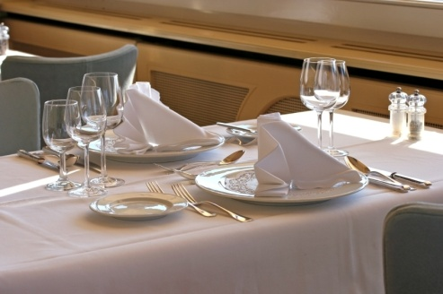
Interpret policies & procedures for provision of valet services
Policies & procedures may relate to:
Service standards & protocols
When valet service is provided
Ratio of valets to guests
Forms of address
Action relating to service provided
(Continued)
Notes:
Trainer gives examples of possible venue-specific policies and procedures relating to the provision of valet services, identifying
Service standards and protocols . These may address:
When or under what conditions valet service is available or to be provided
Ratio of valets to guests. One valet is unable to effectively cater for large groups of guests and the venue may provide guidance on the number of valets required to cater for different group sizes
How guests are to addressed, prescribing the acceptable forms of address for differing guest types. Many policies in this regard provide advice, for example, on forms of address for royalty and religious leaders
Actions required for delivery of nominated service provisions. Policies and procedures may, for example, stipulate:
Products to be provided – by brand name, type and style
Quantity of products or items per room or per guest
Duration of service delivery
Activities to be provided
Sequence of tasks or activities
Timing requirements, for example, ‘Turn down must be provided by 8:00PM’.

Slide 31

Interpret policies & procedures for provision of valet services
Honesty:
Telling the truth
Only charging for legitimate items or services
Not stealing
Not taking photographs
(Continued)
Notes:
Trainer continues presenting examples of possible venue policies and procedures relating to the provision of valet services to guests:
Honesty. This will cover the need for valets to be honest in all their dealing with guests. In practice this can mean:
Telling the truth about products and services, what the venue can and cannot provide, in response to questions asked by the guest
Only charging guests for what they have received. Only legitimate charges should be applied to a guest’s account: no more, no less
Not stealing – money, property or information you have become aware of as part of your dealings with the guest
Not taking photographs of the guest room or their belongings or activities, or the condition in which they leave their room.
Trainer notes to trainees in some cases they will have to be dishonest with some people (such as other guests, members of the media, unsolicited callers) in order to protect the privacy and security of the VIP guest.

Slide 32
Interpret policies & procedures for provision of valet services
Use of equipment & facilities:
Ban on using venue equipment & facilities for personal use or gain
Ban on using anything belonging to the guest unless specifically instructed by the
guest to do so on their behalf
(Continued)
Notes:
Trainer continues presenting examples of possible venue policies and procedures relating to the provision of valet services to guests:
Use of enterprise equipment and facilities for personal use or gain. There is usually a complete ban on any staff using venue items for their private use. Obviously there is also a total ban on valets using guest items unless specifically told or invited to do so.

Slide 33

Interpret policies & procedures for provision of valet services
Treatment of VIPs:
Prepare required items in advance or as required
Arrange preferential seating
Demonstrate deferential treatment
Protect privacy & security to a
higher level
(Continued)
Notes:
Trainer continues presenting examples of possible venue policies and procedures relating to the provision of valet services to guests:
Treatment of VIPs – while all guests should be treated by all staff as VIPs the fact is valets must treat their guests in an exceptional manner. Valets may be required to:
Prepare items (products and/or services) for nominated VIPs that are not offered to other guests
Arrange for preferential seating in in-house dining rooms, at functions and for shows and other entertainment
Provide associates of VIPs with the same treatment being given to the actual VIPs
Demonstrate deferential treatment to VIPs. This means always giving the best option, the best that is available and/or deferring to their personal preferences above the standard service provision given by the venue. it is also important valets never appear subservient when doing so highlighting there is a fine line between deference and subservience but it is one the professional valet treads easily and with dignity.
Protect the privacy and security of VIPs to a higher standard than is normally provided for other guests. This may mean liaising with in-house security staff as well as liaising with security personnel accompanying the VIP. Given many VIPs are royalty, politicians, sports stars, movie stars and/or music stars there is regularly a need for valets to:
Be subjected to various security checks
Cooperate with security personnel
Provide misleading information to others

Slide 34
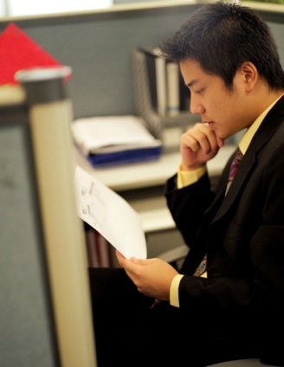
Interpret policies & procedures for provision of valet services
Complimentary goods & services provided as standard
Discretionary authority
Reporting procedures.
Notes:
Trainer continues presenting examples of possible venue policies and procedures relating to the provision of valet services to guests:
Complimentary goods and services to be provided as part of the standard valet service such as, for example, lowers in the room, turn-down service, drinks on arrival. Not only will VIPs receiving valet service receive items not provided to other guests, they will also normally:
Receive more of them
Receive a higher-quality version of what is normally supplied.
Discretionary authority. Valets traditionally have a significant scope of authority to allow them to deal with the wide range of issues their guests present them with. The scope of authority may relate to:
Ability to act on behalf of the venue without needing to refer to or confer with anyone else (manager, owner) before taking action
Authority to spend money on behalf of the venue – usually up to a nominated amount
Authority to act in given situations – such as when there is a problem or potential complaint as well as in the event of an emergency
Reporting procedures – for communicating with other staff (and persons external to the venue – such as contractors, officials and the authorities), in the event of a need to:
Manage an emergency
Charge expenses to the room/individual VIP
Report an issue or incident
Advise of new or revised VIP guest needs
Confirm existing arrangements.

Slide 35
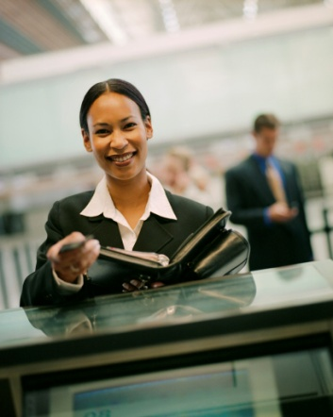
Identify & explain the role of communication in valet service
Good & effective communication is vital to develop trust & confidence – important aspects are:
Being aware of pre-arrival requests
Having good levels of product knowledge
Providing comprehensive, accurate &
current information
Being proactive
(Continued)
Notes:
Trainer highlights to trainees that communicating with guests is a critical aspect of the valet’s role because it is the basis of the trust and confidence necessary in the relationship between valet and guest.
Trainer states that trainees can optimise the development of trust and confidence between them and the guest by:
Being aware of the needs of the guest before they arrive. This means reading reservation or ‘Special Request’ details commonly provided by or for VIP guests prior to their arrival
Having extremely high levels of product knowledge about:
All the products, services and facilities of the venue
All venue policies and procedures
The local area – amenities, infrastructure, shopping, dining, industry, authorities, travel and transport, features and tourist attractions (natural and man-made)
Making sure beyond all doubt everything told, explained or discussed with the guest is true, up-to-date and accurate. This helps to build credibility which is the basis of trust and confidence
Being proactive. A valet must demonstrate initiative to prove they are thinking and acting on the guest’s behalf and to their advantage and benefit

Slide 36
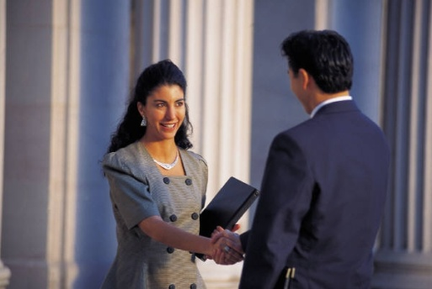
Identify & explain the role of communication in valet service
Keeping promises made
Not interfering.
Notes:
Trainer continues to give trainees information about how valets can develop trust and confidence between them and the guest:
Always ensuring any promises are kept when promised, and as promised without exception. The guest will always judge a valet by their actions rather than their words – valets must always ‘walk the talk’.
Not interfering. The role of the valet is to serve and not to direct. Valets must cultivate the capacity to allow their guests to be who they want to be and do what they want to do. Working quietly in the background is key to this while, at the same time, listening and observing the guest, with a view to anticipating what guest needs may be so they can be effectively addressed.

Slide 37

Identify & explain the role of communication in valet service
Good communication between valet & guest also enhances:
Rapport
Goodwill.
Notes:
Trainer indicates to trainees that good and effective communication will also enhance the rapport and goodwill towards the guest which is comprised of elements such as:
Friendliness towards the guest
Approval of the guest and who they are and what they do
Willingness to help and be of service
Adding value to transactions and dealings by virtue of the human level of contact and the personal feelings involved
Positive feelings towards the guest
Interest in the guest and what they have done, are doing and are going to do.

Slide 38

Identify & explain the role of communication in valet service
Important standards of communication:
Listen
Observe
Know when to speak – and when not to
(Continued)
Notes:
Trainer presents to trainees important standards relating to communication between valets and guests:
Listen – always be alert to:
What the guest is saying
What others around the guest are saying
Questions asked by the guest
Any noise or sound giving rise for concern or action – such as the room door bellringing, the telephone ringing, a crashing noise
Observe – constantly monitor:
What the guest is doing or appears about to do
The activities of others in the company of the guest
The performance of equipment such as lights and appliances
Know when to speak and when not to speak. Being a valet is not the same as being a bar attendant, waiter or other frontline staff member and a different protocol applies. The valet seeks to be a background presence rather than an obvious presence. They must not intrude yet be available when required. A valet is not required to supply casual banter, witty remarks or offhand comments on events they may see, or on comments they may hear. The principle of ‘seeing everything and saying nothing’ definitely applies.

Slide 39
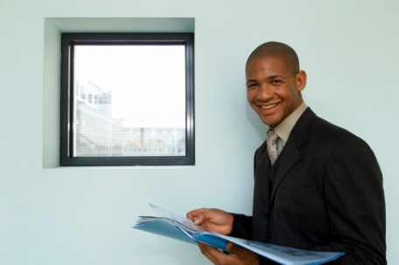
Identify & explain the role of communication in valet service
Maintain confidences:
Of guests
Of support staff
Of family members
Of facts, figures, information, observations
A second language is beneficial.
Notes:
Trainer continues to present to trainees important standards relating to communication between valets and guests:
Valets must never communicate hotel secrets to their guests, nor communicate guest secrets to others. All information received from the guest must be treated as confidential and not discussed with others (colleagues, friends or others). Similarly all observations in relation to the guests (how they behave, how they treat others, their level of intoxication, how neat or untidy they are in their room) must be kept confidential. Guests who use valets often bring public relations people and other staff (security, personal assistants, cooks) with them for the duration of their stay. This means valets:
Sometimes need to speak to the guest's personal staff to access information about the guest, determine their preferences, or identify their requirements
Must keep information provide by these people confidential – that is, this information must be treated as coming directly from the guest
Must keep confidential any conversations or observations regarding the support staff in the same way conversations and observations of the guest will be kept confidential.
A second language is always seen as a bonus for anyone seeking to be a valet being bilingual or multilingual is definitely an advantage and having high-level English language skills are also regarded as necessary in most venues and in most countries.

Slide 40

Identify & explain the role of communication in valet service
Principles of effective communication:
All messages must have a purpose
Messages should match interest & ability of guest
Eliminate unnecessary words
Use words the guest will
know/understand
Messages must be clear & concise
Speak calmly & slightly slower than normal.
Notes:
Trainer provides trainees with principles of communication designed to aid effective communication:
Every message must have a purpose. If there is no need to say anything, do not speak. Always think before talking, and plan what you are going to say and how you are going to say it
Messages should match the interests and abilities of the guest. Conversation should focus on the guest as opposed to focussing on the valet. Conversation, for example, must focus on what the guest has done and where they have been rather than on what the valet has done or their experiences.
Unnecessary words should be eliminated. Conversation between the valet and the guest should be limited in nature. The aim is to be direct without appearing short or rude. This respects the guest and demonstrates it is the guest who is in charge of the situation; the valet is there to serve. It is acceptable (and part of the valet’s role) to engage in long conversations with the guest when the guest initiates such discussion.
Chosen words should be within the experience range of the guest. If you are going to use local language, terms or phrases when talking to the guest then it is imperative these are explained first. Explaining these things enhances the guest’s experience and prevents embarrassment caused if the guest does not know what is being discussed.
Verbal messages should be clear and concise. Use the correct words and with correct pronunciation, along with appropriate inflection, tone, language, speed and volume of voice.
Speaking calmly is recommended. Speaking at a slightly slower speed than normal is also regarded as useful (especially where accents may cause a problem) and helps to create a more considered and gracious ambience.

Slide 41

Identify & explain the role of communication in valet service
Good communication is vital to:
Meet guest expectations
Identify guest requirements
Assist/serve the guest
Create desired ambience
Facilitate relationships.
Notes:
Trainer indicates to trainees good communication between valets and guests is important to:
Meet guest expectations regarding service delivery
Identify guest needs, wants and preferences so they can best be addressed
Assist the guest in whatever ways they may want
Create the desired atmosphere of service, dignity and exclusivity
Facilitate all relationships between the guest and the venue and enhance rapport, trust and goodwill.

Slide 42
Summary – Element 1
When identifying the role of a valet:
Seek to identify roles & duties they are expected to undertake from management & guest perspective
Read the job or position description
Talk to management and more senior
and experienced staff
(Continued)
Notes:
Trainer provides a recap of the Element asking questions to check trainee understanding and responding to questions from trainees, as required.

Slide 43
Summary – Element 1
Determine the way the position fits into the organisational chart & how it integrates with other positions
Ascertain & comply with required personal characteristics
Determine & demonstrate appropriate
grooming & personal presentation
(Continued)
Notes:
Trainer provides a recap of the Element asking questions to check trainee understanding and responding to questions from trainees, as required.

Slide 44
Summary – Element 1
Access, read & understand venue policies & procedures relating to the delivery of services by a valet
Establish the personal scope of authority applicable to the role
Appreciate the need for excellent levels of communication to establish rapport,
goodwill & trust, & to determine and
clarify guest want, needs & preferences.
Notes:
Trainer provides a recap of the Element asking questions to check trainee understanding and responding to questions from trainees, as required.

Slide 45
Prepare to deliver valet service
Performance Criteria for this Element are:
Obtain guest information in advance of guest arrival
Determine guest requirements & preferences
(Continued)
Notes:
Trainer identifies for trainees the Performance Criteria for this Element, as listed on the slide.

Slide 46

Prepare to deliver valet service
Liaise with other staff & external service providers to meet anticipated guest needs
Check guest room prior to guest arrival to ensure compliance with stated requests.
Notes:
Trainer identifies for trainees the Performance Criteria for this Element, as listed on the slide.
Class Activity – Discussion
Trainer asks trainees questions regarding preparation activities undertaken by valets in readiness for guest arrival:
What guest information may need to be obtained for a VIP or valet-serviced guest?
What information might VIP/valet-serviced guests provide?
How might this information be provided?
What is ‘guest history’ and how can it assist with providing service to a guest?
Why is it important for a valet to know about their guest’s needs, wants and preferences prior to their arrival?
How might other staff at a venue assist a valet to deliver high-quality services to a guest?
What things may need to be done to a guest room to prepare it for the arrival of a VIP/valet-serviced guest?

Slide 47
Obtain guest information in advance of guest arrival
Obtain guest information prior to their arrival so you can:
Learn about the guest
Identify individual needs, wants & preferences
Meet expectations.
Always be proactive in obtaining
this information.
Notes:
Trainer advises trainees they need to obtain guest information for valet-serviced guests before these guests arrive so they can:
Learn about the guest – knowledge is power when used to satisfy the guest. The more knowledge known about the guest to be served, the better those needs can be met
Identify their individual needs, wants and preferences – so service delivery can be tailored to meet their personal needs
Meet expectations – where valet service is provided, VIP guests have high expectations about the standard of service received, and how they will be welcomed and treated. Meeting (or exceeding) guest expectations is important in relation to:
Attracting return/repeat business
Obtaining positive word-of-mouth advertising and endorsements.

Slide 48

Obtain guest information in advance of guest arrival
Always be proactive in obtaining guest information:
Contact the guest or their staff, if necessary
View internal guest history
Read documentation accompanying reservation
Talk to other staff.
Notes:
Trainer stresses to trainees they must always be proactive in obtaining guest information prior to their arrival indicating this may involve:
Ask management to contact the guest – and request information from them where this is deemed necessary or important, or alternatively:
Contact guest support staff (such as personal assistants) to obtain information from them about the guest, their requirements and other relevant details.
View internal guest history – which will provide information about their needs, wants and preferences as well as indications about what used and/or required on their previous stays (including information on problems, complaints and compliments). Guest history will not be available where the guest has not stayed previously at the venue: if the guest has stayed previously at a venue in the same chain of hotels, then contact the venues where they have previously stayed to obtain their guest history for the guest
Read information accompanying the reservation – many valet-serviced guests/VIPs will make specific demands relating to their needs and preferences
Talk to other venue staff – to gain the benefit of their experience and knowledge

Slide 49
Obtain guest information in advance of guest arrival
Pre-arrival guest information may include:
Names & details
Title/s
Special requests
Personal preferences
(Continued)
Notes:
Trainer explains to trainees the pre-arrival information for valet-serviced guests will vary greatly between individual guests but can include:
Name/s of the VIP/VIPs and those in their party. Their ‘party’ can include:
Spouse or partner
Children – including their age and special requirements for them:
Entertainment
Food and drinks
Child-minding
PA/s and/or agent/s
Retinue – such as security, cooks, hairdressers, make-up people, advisors, media personnel, nannies, doctors
Title (if appropriate) – and how the person is to be addressed:
‘Your Majesty’
‘Your Holiness’
Country/culture-specific forms of address and respect to be employed
Special requests. These can relate to specific tasks to be undertaken when the guest is in the venue or during their stay in the city. Valets may be asked to run errands, arrange bookings or functions, obtain nominated items, meet with designated people. There really is no limit to the range of things a valet may be asked to do for a guest.
Personal preferences – more information in next Section but this relates to individual likes and dislikes for products and services, brand names, timing and duration of service delivery, seating preferences for dining reservations.

Slide 50
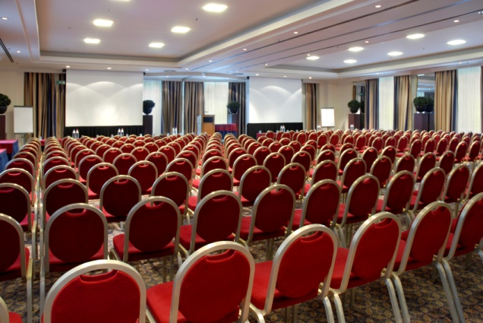
Obtain guest information in advance of guest arrival
Itinerary for the duration of the stay; not all guests will provide this
Functions and events required by the guest and all related details & requirements.
Notes:
Trainer continues to give trainees examples of the pre-arrival information a valet may have (or need to identify) for valet-serviced guests:
Itinerary (or ‘Schedule’). This is a list of what the guest is doing during their stay, where they are going and when it is all happening. This is provided so the valet (and other venue staff) can make sure they accommodate guest needs. Schedules can range from the very detailed (almost a minute by minute list) to the very general (indicating only ‘AM/PM’). Not all guests who use a valet will provide an itinerary.
Functions to be organised – see Class Activity (below, this slide).
Class Activity – Whole of class exercise
Trainer states to class that a VIP guest has indicated they require the valet to organise a function for them while they are staying at the venue.
Trainer asks class to contribute information the valet needs to obtain to make the function a success.
Possible answers include:
When they are required – date, start and finish times
Numbers attending and who the venue needs to invite if any; the guest may issue the invitations)
Where they are to be held – in the venue or at another location?
Menus and drinks required
Entertainment
Budget
Ancillary requirements – theme for the function/event, colour scheme, displays.

Slide 51
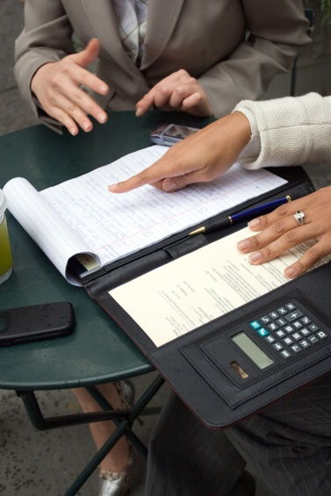
Determine guest requirements & preferences
On arrival, solicit extra information about guest requirements & preferences:
Use common sense
Speak to guest &/or ask staff, family or agent
Clarify valet attendance requirements
Be prepared for change to existing
arrangements
Take notes.
Notes:
Trainer advises trainees once the valet-serviced guest (or their staff/entourage) has arrived, additional information about their requirements and preferences should be solicited to supplement information already obtained:
Use common sense to determine what to provide/offer – based on personal, venue and/or local knowledge, and what you see and hear ‘at the time’
Ask the guest or their staff/representatives. This should be done:
As soon as possible – the sooner these questions are raised and answered, the better. Never leave asking these questions till the last minute
By offering or describing options available – where the guest is unaware of what is available
Clarify specific valet attendance requirements – identifying times the guest requires valet service for nominated activities in addition to anticipated (or traditional) services to be provided. Also identify the times they want to be left alone.
Be prepared for changes. There are nearly always changes needing to be made to pre-existing arrangements so be ready for them and never show frustration or annoyance. Changes may be required in terms of:
Dates and times of arrangements
Types and nature of products and services
Numbers and quantities
Take notes when receiving input about guest needs – never rely solely on memory.

Slide 52

Determine guest requirements & preferences
Personal preferences & requirements can relate to:
Specific brand names
Newspapers &/or magazines
Colours of ‘Smarties’ to be provided
(Continue)
Notes:
Trainer provides trainees with examples of things valet-serviced guests may have personal requirements and/or preferences in relation to:
Specific brands – of beverages and/or food
Newspapers and/or magazines – to be provided in-room, or on arrival
Colours of ‘Smarties’ to be supplied – as well as a wide range of peculiar similar requests.

Slide 53
Determine guest requirements & preferences
Temperature setting for air conditioner
Calls to the room
Transport
In-room services.
Notes:
Trainer continues to provide trainees with examples of things for which valet-serviced guests may have personal requirements and/or preferences in relation to:
Setting of temperature for air conditioning – indicating a nominated temperature
Calls to the room – for reminding guests about meetings, important times and wake-up calls
Car/transport – detailing type of vehicle and sometimes the preferred car rental company; also there can be need for provision of a driver
In-room services – meals, massage, business support, small parties.

Slide 54
Determine guest requirements & preferences
Individual requirements for service provision may also entail:
Organising excursions/tours
Making bookings
Arranging meetings
(Continued)
Notes:
Trainer further advises trainees individual requirements for service provision to valet-serviced guests may also embrace:
Organising excursions/tours to local events, sites, attractions, parks, activities. These may be as part of wider or commercially available trips. There can be a requirement to plan and organise a tour or trip just for the guest and their party
Making bookings – for restaurant/theatre
Arranging meetings – with local identities, authorities, personalities or nominated other people, businesses or groups

Slide 55
Determine guest requirements & preferences
Providing advice about personal services
Making travel arrangements.
Notes:
Trainer continues to advise trainees regarding individual requirements for service provision to valet-serviced guests:
Providing advice about personal services such as hairdressing, medical, legal and shopping
Making travel arrangements or confirming or changing them.
Class Activity – Guest Speaker
Trainer arranges for an experienced valet to attend and talk to trainees about:
Their work as a valet and what it entails
Their experiences with guests and their requests, idiosyncrasies and demands
The good and bad aspects of working as a valet
Tips and advice for trainees
Venue requirements relating to the work or duties of valets
The nature of the relationship between valets and guests.

Slide 56

Liaise with others to meet anticipated guest needs
Teamwork & interaction with others is always needed to optimise valet-serviced guest experiences:
Meet with other venue staff to:
Discuss the visit or stay & make arrangements
Share information
Organise guest arrival
Notify others about VIP guest arrival
(Continued)
Notes:
Trainer explains to trainees while valets provide personal service to guests, the total guest experience relies on teamwork and the cooperation of other staff within the venue as well as outside businesses/suppliers or service providers and the guest (or their representatives).
Trainer identifies when meeting with other venue staff this is done in order to:
Discuss guest stay and make necessary arrangements; what needs to be done and when and who will do what
Share original information about the stay or guest and any information obtained subsequent to this that changes previous knowledge, service delivery requirements or planning
Organise the arrival of the guest which may involve:
Pick-up and transfers
Readying/preparing the guest room/s as required
Organise refreshments or meals
Security and privacy arrangements
Luggage movement
Notify other staff and/or departments of guest arrival. Depending on the nature of the arrival this may require:
Informing management so they can welcome the guest
Advising Front Office/Reception especially where management or the valet handles guest check-in. There can be situations where, rather than requiring the guest to complete standard check-in procedures, these are undertaken elsewhere (such as in the guest room)
Confirming guest numbers with the Kitchen and/or Food and Beverage department. This is important where the guest will be eating in-house
Notifying internal Security regarding:
Numbers of guests
Room numbers
Arrangements made by security personnel accompanying the guest
Contacting Housekeeping – to:
Confirm arrival
Verify guest numbers
Communicate or verify room allocations
Request special services if and as required.
Communicating with whatever personnel or departments are necessary to respond to guest needs and requests as they are identified on arrival.

Slide 57

Liaise with others to meet anticipated guest need
Contact external service providers:
Advise updated information
Confirm existing arrangements
Clarify details/issues
Communicate last-minute details
(Continued)
Notes:
Trainer describes to trainees issues needing to be covered when meeting with external providers/suppliers prior to a valet-serviced guest arrival:
External service providers – where provision of services or products for the guest stay relies on external providers, the valet must:
Contact them – in person, face-to-face or by phone
Advise of updated information – as notified by the guest
Confirm other existing arrangements – as appropriate/previously arranged with the business
Clarify issues – as required by the provider
Communicate last-minute details – such as:
Timing and scheduling
Room numbers
Names of venue staff who will be involved
Final requirements for integration of activities/service provision.

Slide 58
Liaise with others to meet anticipated guest needs
Contact the guest or their representative:
Identify & introduce yourself as the valet
Provide contact details
Welcome the guest
(Continued)
Notes:
Trainer identifies for trainees issues needing to be addressed when contacting the guest or their representatives prior to a valet-serviced guest arrival explaining there is nearly always a need to speak with the guest or their staff to:
Perform identification of self as the valet and do initial introduction
Provide contact details such as work cell phone, pager number or extension number
Welcome the guest and their entourage

Slide 59

Liaise with others to meet anticipated guest need
Make an offer of service
Request changes to existing arrangements
Confirm existing other arrangements
Seek answers to questions.
Notes:
Trainer continues to explain what may need to be addressed when contacting the guest or their representative prior to a valet-serviced guest stay:
Make an offer to be of service – indicating right from the outset the desire to be of service
Ask for changes to previously arranged plans, schedules and requirements – take notes to record these
Confirm existing arrangements – verbally: it is best to state these to the person rather than rely on the basis of ‘if it has not been mentioned, it has not changed’
Seek answers to questions – for example, where the guest was presented with options but has not (at this stage) decided which option to select.

Slide 60
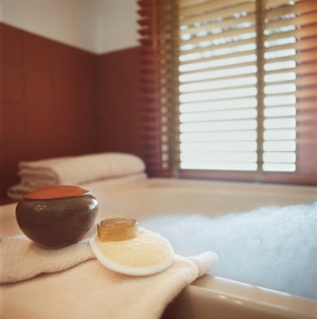
Check guest room prior to guest arrival
The valet should be involved in guest room set-up:
Ensure requested requirements are complied with
Participate in cleaning & servicing
Apply house standards where there are no specific guest instructions or preferences
Check the final presentation of the room.
Notes:
Trainer states all rooms to be used by guests receiving valet service must be inspected and checked to ensure they comply with requests by the guest and house protocols.
Trainer advises the valet responsible for service provision when the guest arrives should be involved in the initial preparation of the room highlighting when preparing the guest room a valet should:
Ensure any notified requirements are catered for to the best extent possible in accordance with identified guest needs, wants and preferences
Be involved in the cleaning and preparation/set-up of the room. The finished product always seems to be better if the valet who will provide service in the room is involved in cleaning and servicing the room
Prepare the room according to venue standards where the guest has not specified alternative requirements. In practice this can mean:
Turning nominated lights on and/or off in different sections of the room, or in different rooms of the suite
Setting the air conditioning
Setting the levels of sound for the radio, sound system and/or television
Setting the radio and television to nominated stations/channels
Setting the time on clocks in the room
Opening or closing drapes and curtains
Check the final presentation of the room – see following slides

Slide 61
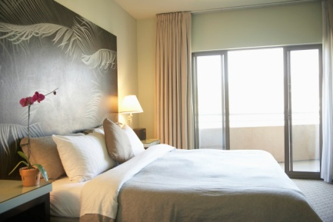
Check guest room prior to guest arrival
The room for the guest:
Must be checked & inspected to verify it is ready
Must be ready to receive the guest 3 hours before ETA.
Notes:
Trainer suggests the room or suite to be occupied by the VIP guest must be ready to receive the guest at least three hours prior to their anticipated arrival meaning the room has been inspected and checked, and deemed to be ‘ready’.
Trainer explains ensuring the room is ready at least three hours early allows:
Time to address identified shortcomings as a result of the checks/inspections
The guest to be accommodated should they arrive early.

Slide 62
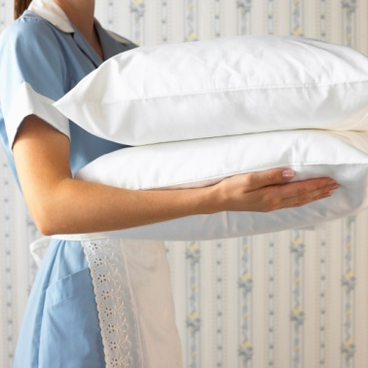
Check guest room prior to guest arrival
The guest room or suite may be inspected by:
Room attendants who cleaned or serviced the room
The Floor Housekeeper
The Executive Housekeeper
Management
The valet/s.
Individual inspections are better than
‘group’ inspections.
Notes:
Trainer instructs trainees that the final inspection and checking of a valet-serviced guest room or suite may be undertaken by:
The room attendants who clean or service the room
The Floor Housekeeper
The Executive Housekeeper
Management
The valet/s.
Trainer advises trainees:
The inspections are traditionally more effective if undertaken separately rather than having everyone inspect the room at the same time
These inspections must be scheduled and entered into appropriate diaries and work schedules to ensure they are done and not forgotten.

Slide 63

Check guest room prior to guest arrival
The inspection of a valet-serviced guest room prior to guest arrival should:
Use a checklist to guide the inspection
Cover all aspects of the room/suite
Check & confirm equipment/system
settings
(Continued)
Notes:
Trainer provides advise to trainees regarding the inspection of a valet-serviced guest room prior to guest arrival:
Use a pre-prepared checklist to guide the inspection. This list will, in part, be based on the requirements for the guest as communicated to the venue
Cover all aspects of the room/suite, for example:
Floors, walls, ceilings and carpets
Fixtures, furniture and equipment
Appliances and equipment, systems and technology including remote control devices
Interior aspects as well as outside areas such as patios, balconies and court yards
External appearances (of cabinets, drawers, cupboards, wardrobes) as well as inside cleanliness and condition
Presence and physical location of all complimentary products
Door locks function smoothly and effectively
Check previously set settings to equipment (radios, lights, television, systems, clocks) and confirm:
Operation of all electrical equipment, lights, refrigeration
Ice is provided as required or in accordance with house requirements
Refrigeration is at correct setting
Alarm clock is not set to avoid it waking the guest up when not required
Telephone and internal communication (message lights, on-screen/television-based) systems are fully operational
TV & radio set to required stations and volume set as required.

Slide 64

Check guest room prior to guest arrival
Confirm all ‘on arrival’ items are in place as required
Look
Sniff
Listen.
Notes:
Trainer continues to advise trainees regarding checks and inspections on guest rooms prior to their arrival:
Confirm the presence of ‘on arrival’ items such as:
Flowers in vases and/or bouquets
Gifts and/or gift baskets
Tickets to events, shows or the theatre
Confirmation of reservations for dining, personal services, tours
Merchandise/products specifically requested by the guest to be available on arrival – food, reading material, confectionery, drinks, clothing
Use all the senses, for example:
Check everything looks clean, tidy and as it should be – special attention must be paid to windows and mirrors
Check everything smells as it should with special attention to ‘off’ odours in respect of carpets, refrigeration, toilets and confined spaces
Check everything sounds as it should – no excess or unacceptable levels of noise from fans, refrigeration, heaters or other appliances or systems.
Class Activity – Head/Executive Housekeeper
Trainer arranges for a Head/Executive Housekeeper from a venue where valets are used to attend and talk to trainees about:
The roles and responsibilities of valets
How valets should communicate and interact with other venue staff
The nature of the relationship between valets and other venue staff
Qualities required for a person to be a good valet
Preparing a room/suite for arrival of a valet-serviced guest
Products and services provided to valet-serviced guests that are not provided to other guests
Anecdotes involving valets.

Slide 65
Check guest room prior to guest arrival
Always take action to address identified short-comings when inspecting a guest room:
Cleaning again
Replacing items
Undertaking maintenance
Re-rooming the guest.
Notes:
Trainer emphasises to trainees that checking or inspecting the guest room or suite is not an end in itself. This means it is crucial that necessary action is taken to address any identified problems or shortcomings. Necessary remedial action may include:
Re-cleaning the room – or parts of it
Replacing items – furniture, fixtures or appliances
Undertaking maintenance – or repairs
Re-rooming the guest – moving the guest to another room if suitable remedial action to the original room cannot be effected.

Slide 66
Summary – Element 2
When preparing to deliver valet services:
Obtain & check pre-arrival notifications received from the guest or their representatives
Be proactive in obtaining pre-arrival
notifications – never just wait for
information or instructions to arrive
(Continued)
Notes:
Trainer provides a recap of the Element asking questions to check trainee understanding and responding to questions from trainees, as required.

Slide 67
Summary – Element 2
Search internal guest history to determine previous guest preferences
Never be afraid to talk to the guest on or after arrival to determine requirements or clarify expectations
Under-promise & over-deliver
(Continued)
Notes:
Trainer provides a recap of the Element asking questions to check trainee understanding and responding to questions from trainees, as required.

Slide 68
Summary – Element 2
Liaise with other staff to include them in the provision of service & in meeting expectations – never feel it is all up to you
Participate in preparing the guest room in accordance with house protocols & specific
guest instruction/s
Ensure room is ready well before
guest ETA
(Continued)
Notes:
Trainer provides a recap of the Element asking questions to check trainee understanding and responding to questions from trainees, as required.

Slide 69
Summary – Element 2
Meet & liaise with other staff & management to organise for the arrival & presence of the guest
Double-check the guest room just prior to guest arrival.
Notes:
Trainer provides a recap of the Element asking questions to check trainee understanding and responding to questions from trainees, as required.

Slide 70
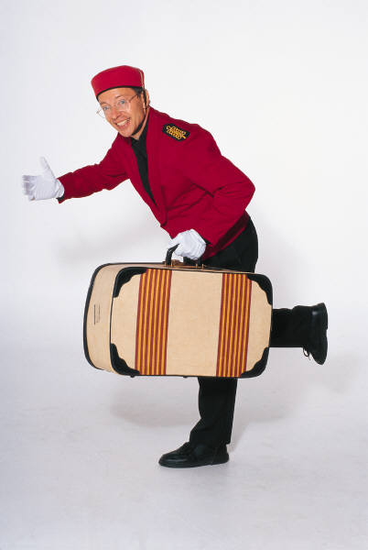
Deliver valet services
Performance Criteria for this Element are:
Welcome guest on arrival & establish
appropriate rapport
Advise guest of available services
Deal with guest luggage
(Continued)
Notes:
Trainer identifies for trainees the Performance Criteria for this Element, as listed on the slide.

Slide 71

Deliver valet services
Deal with guest clothes
Deal with guest requests
Deliver enterprise-specific VIP
treatment & services
(Continued)
Notes:
Trainer identifies for trainees the Performance Criteria for this Element, as listed on the slide.

Slide 72

Deliver valet services
Adjust service-delivery to suit guest needs & preferences
Maintain guest privacy & confidentiality
Assist with pre- & on-departure services.
Notes:
Trainer identifies for trainees the Performance Criteria for this Element, as listed on the slide.
Class Activity – Discussion
Trainer asks trainees questions regarding the delivery of valet services asking questions such as:
What is involved in delivering valet services?
How might a valet welcome a valet-serviced guest?
What might be involved in dealing with guest luggage on their arrival?
What tasks might valets be required to undertake in relation to guest clothing during their stay?
What sort of special requests might guests make of valets?
What do you think valets should do if asked by a guest to do something illegal and/or dangerous?
What examples can you think of where valets could adjust service delivery to suit the identified or stated needs or preferences of valet-serviced guests?
Why is it important for valets to protect and maintain guest privacy and confidentiality?
What pre- and on-departure activities may a valet assist their guests with?

Slide 73

Welcome guest on arrival & establish appropriate rapport
Valets should be present to welcome the guest, introduce themselves and begin rapport building. Important elements are:
Consistent professional manner
Politeness & courtesy
Application of correct etiquette
Using correct guest name
(Continued)
Notes:
Trainer states an important starting point for the relationship between valets and guests is for the valet to be in attendance when the guest arrives to welcome them, introduce themselves and commence the process of rapport building.
Trainer mentions all communication between valets and guests must be characterised by the following points, some of which have also been discussed but which warrant repeating because they are all part of rapport building:
Consistent use of a professional manner by the valet in all dealings with guests
Politeness and courtesy – showing respect for the guest
Use of correct etiquette at all times – behind closed doors as well as when in public
Use of guest name at all times – or an appropriate alternative such as ‘Sir’ or ‘Madam’

Slide 74

Welcome guest on arrival & establish appropriate rapport
Truthfulness
Use tact, diplomacy & discretion
Distinguish facts from opinion
Maintain privacy & confidences
Show ongoing willingness to be of help.
Notes:
Trainer continues to indicate communication tips to assist with rapport building with guests on their arrival:
Being truthful at all times. Honesty about everything at all times is essential. The valet needs to create a relationship with the guest such that the guest can rely on what the valet says as being 100% true and accurate. While the valet must be tactful, they are not expected to tell lies.
Being tactful, diplomatic and discrete to protect the reputation, sensitivities and image of the guest
Indicating when a personal opinion is being given as distinct from facts
Maintaining privacy and confidentiality issues relating to the guest and their stay so other people who do not need to know are not made aware of guest activities, conversations and meetings. More will be provided on later slides on this topic.
Exhibit a constant willingness to assist demonstrating ‘nothing is too much trouble’ and it is a pleasure to serve.

Slide 75

Welcome guest on arrival & establish appropriate rapport
Welcoming a valet-serviced guest can entail:
Pre-arrival activities
Formal ‘on arrival’ welcome activities
The more private ‘in-room’ welcome
to the guest.
Notes:
Trainer explains to trainees that ‘welcoming a valet-serviced guest’ can comprise three stages:
Pre-arrival activities – covered on the next two slides
Formal on arrival activities – the ‘public’ welcoming of the guest. Discussed on later slides
The more personal welcome of the guest by the valet in the relative privacy of their room or suite. This is also discussed in more detail in this section in later slides.

Slide 76
Welcome guest on arrival & establish appropriate rapport
Pre-arrival activities may include:
Confirm people in the guest’s party with Reception
Practice saying the guest’s name
Identify the correct form of address for the guests
Make a last minute check of the
guest’s room
(Continued)
Notes:
Trainer explains to trainees the pre-arrival welcome activities that may need to be undertaken prior to the arrival of a valet-service guest:
Confirm the people in the guest’s party with Reception – by name and number
Practice saying the guest’s name where the name is unusual, difficult to pronounce or the guest is from another country
Identify the correct form of address for the guests where relevant to ensure the guest is addressed in the most polite and appropriate form as applicable to their position
Make a last minute check of the guest room or suite to verify all is ready for the arrival of the guest

Slide 77

Welcome guest on arrival & establish appropriate rapport
Conduct or participate in a staff briefing
Meet with management to discuss & organise the arrival.
Notes:
Trainer continues to explain to trainees the pre-arrival welcome activities that may need to be undertaken prior to the arrival of a valet-service guest:
Conduct or participate in a staff briefing. Where a VIP is expected in the venue it is SOP for all staff to be briefed about:
The name/s of those arriving – the VIP guest and all those in the party
Schedule for the party detailing what the guest/s will be doing and when they will be doing it
Allocation of roles and responsibilities to staff for service delivery to the guest and their party
Special arrangements made by the venue that are different to normal or standard practices and procedures as required by the guest and as organised by the venue for the guest
Things the staff must do and must not do while the guest and their party are in residence at the venue
Ancillary aspects of the visit such as Security arrangements, Media access to the guest, and Special events the guest will be hosting or attending
Meet with management to discuss and organise the arrival. This should address:
Where the guest will arrive. Options may be for normal entry through the front doors of the venue, or discrete entry using an alternative (back or side) door
Expected time of arrival
Activities organised as part of the arrival covering issues such as:
Registration
Introductions to staff and others
Media obligations and photo opportunities
Who will be present to greet the guest. In many instances there can be a need to accommodate attendance at the arrival of a VIP by Head office staff/management and/or dignitaries and officials
Media attendance – venues will always try to accommodate the media and give them access while at the same time protecting the guest
Security arrangements relating to crowd control, vehicle access and screening of individuals and luggage, items and cars
Transportation of luggage to the room – identifying how this will occur
The sequence in which ‘welcoming the guest’ will occur by identifying the order in which management, staff (including the valet) will be introduced to the guest.

Slide 78
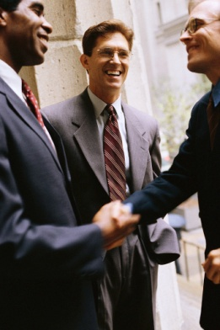
Welcome guest on arrival & establish appropriate rapport
Formal ‘on arrival’ welcome for a VIP guest may include:
Manager introduces key staff
Key staff give brief word of welcome
Hand shaking is not usual – decide
in advance
No touching of the guest is appropriate.
Notes:
Trainer explains to trainees what may be involved in the formal ‘on arrival’ welcome of a valet-serviced guest or VIP:
The venue Manager introduces key staff by name and title to the guest.
A very brief word of welcome is given to the guest by each staff member.
Generally speaking:
There is no shaking of hands; a decision needs to be made in advance about whether or not hand shaking should occur. This could involve communication before arrival with the guest or their agent to identify guest preferences. Staff should be alert to the need to shake hands if the guest offers to do so
Hands are not shaken with women unless they offer their hand
No other form of touching is permitted or appropriate – such as hands on shoulder, touching an arm, or kissing.

Slide 79
Welcome guest on arrival & establish appropriate rapport
The in-room welcome by a valet:
May be made to the guest and/or their representative or party
Uses the guest’s name
Introduces themselves & their role
Confirms action on advised requests
& requirements
Invites questions
Makes an offer of immediate assistance.
Notes:
Trainer explains to trainees what may be involved in the less formal and more private in-room welcome a valet provides to a valet-serviced guest in which the valet:
May welcome the guest and/or their representative such as friends, family, agent, manager or PA
Uses the guest’s name and greets them and welcomes them to the venue
Introduces themselves by name and position
Confirms guest’s previously advised requests have been taken care of and identifies any issues arising, or instances where immediate decisions are required from the guest or their representative
Invites questions and further requests
Makes an offer of immediate assistance or a statement indicating they are ready to help in any way.

Slide 80
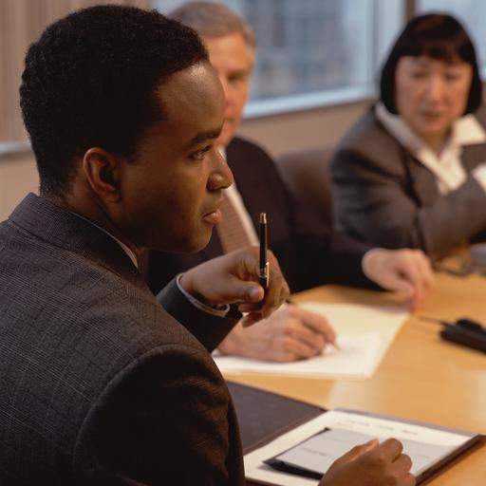
Advise guest of available services
After guest has settled in, advise them of services available:
Teamwork is important
Product knowledge is the basis
No-one can ever know everything:
Apologise
Find out the answer
Tell the guest.
Notes:
Trainer informs trainees when the guest has settled into their accommodation the valet should be ready to advise them regarding all the services available to optimise the satisfaction or effectiveness of their stay. Highlighting:
Teamwork is important – other staff can assist with this process. Much of the work of the valet involves getting things done through the work of others
Product knowledge is the basis. Valets must have very high levels of knowledge about the venue, its products and services as well as the local area and what it has to offer
No-one can ever know everything – where the answer to a guest enquiry is not known:
Apologise to them for not knowing – tell them the answer will be researched
Find the answer through research or the work of others
Communicate the required information to the guest.

Slide 81
Advise guest of available services
Valet service include:
Providing general valet services:
General housekeeping duties
Making tea & coffee
Preparing clothes & footwear
Doing errands
Answering phone & door
(Continued)
Notes:
Trainer provides trainees with examples of services a venue may be able to offer guests:
Providing general valet services
These services include but are not limited to:
Providing general housekeeping duties for the room or suite – tidying and spot cleaning
Making tea and coffee on demand from guests
Preparing guest clothes and footwear to meet guest needs
Undertaking personal errands for the guest such as delivering items, making purchases
Answering the telephone and door and screening callers
Liaising with guest and venue staff to facilitate service delivery
Making arrangements on behalf of the guest within the venue and with external providers.

Slide 82
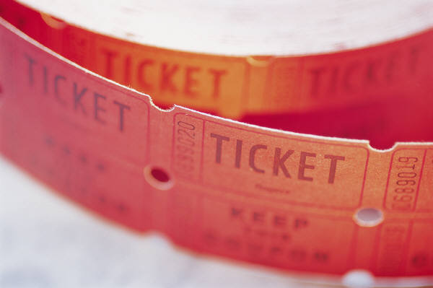
Advise guest of available services
Organising of special functions
Organising of excursions & trips
Making restaurant & theatre bookings
(Continued)
Notes:
Trainer continues to provide trainees with examples of services a venue may be able to offer guests:
Organisation of special functions
These are commonly small functions often conducted in the guest’s suite (such as a small cocktail party) but can include larger gatherings where a bigger area or tables in the dining area (or the Function room) are required.
Valets need to liaise with function, room service and/or food and beverage staff to cater for these requests.
Organisationsof excursions and trips
Where the guest is from another town, region or country they frequently seek advice from valets about day trips and what is ‘best’ to see or what places are worth visiting.
Advice in this regard should reflect any special tastes the guests have. It is always best to enquire as to what sort of things they prefer: do they like natural attractions or do they prefer man-made ones? Have they a liking for history?
Also enquire as to how long they want to spend. Are they seeking a half-day trip, a full-day trip or do they just want to fill in two hours?
Once these points have been clarified make appropriate suggestions and ask if tickets are to be booked or other appropriate arrangements made on their behalf.
Restaurant and theatre bookings
Guests may prefer for bookings to be made for a nominated restaurant or theatre event or guests may ask for advice on where to eat and/or what show to see.
Where guests nominate what they want make sure required times apply and how many people will be going.
Where advice is sought, questions must be asked to determine their preferences (for food and entertainment) before making recommendations.

Slide 83
Advise guest of available services
Arranging room service
Providing general advice
Making or confirming travel arrangements
(Continued)
Notes:
Trainer continues to provide trainees with examples of services a venue may be able to offer guests:
Arranging room service
Rather than order room service themselves guests will often ask the valet to organise it.
If the guest identifies what they want ensure all necessary details are fully understood. For example, how many serves? How is the steak to be cooked? When do they want it delivered?.
Also be alert to the opportunity to upsell by recommending items the guest may have overlooked.
If the guest has not specified what they want, once again, ask questions to identify preferences before making recommendations and/or placing an order.
Depending on house policy – or guest preference – there can be a need to serve the room service order or this may the role of dedicated room service staff.
Providing general advice
Guests often ask the valet about information relating to personal services and it is here where local knowledge will be called on. Providing advice/information on personal services relates to topics such as:
Hairdressing
Medical requirements
Legal
Shopping.
Whilst most of this information is available to guests in the room compendium, the valet is expected to verbally provide reliable and appropriate advice on these topics.
Wherever possible a hard copy of information (such as brochures, maps and ‘What’s on in …’ publications) should also be provided.
The advice from the valet should also include ‘local knowledge’ tips such as:
The best way to get to a location
Who to ask for when they get there/telephone
Places (shops etc.) to avoid and places to make sure they go to.
Making or confirming travel arrangements
It is not common for valets to be asked to make large-scale travel arrangements as most guests already have an itinerary planned and their travel arrangements made, tickets booked etc. In some cases, the agent or management for the guest will handle these issues.
There can however be need for the valet to:
Change travel arrangements – moving the guest to another flight; changing the departure date or time
Make arrangements for day and side trips while the guest is in residence
Contact the airline or travel agent on behalf of the guest to confirm previously made arrangements, or tentative arrangements.
Where there is a problem with any previously made arrangements this needs to be communicated to the guest as soon as possible so the guest can make alternative arrangements. It is critical any request from the guest relating to travel arrangements is acted on promptly.
Any arrangements made on behalf of the guest must be authorised before final confirmation or payment is made and a copy of all relevant paperwork – tickets, itinerary, insurance – must be forwarded promptly to the guest.

Slide 84
Advise guest of available services
Providing wake-up and/or reminder calls
Delivering newspapers & coffee in the morning
Ordering & serving breakfast
(Continued)
Notes:
Trainer continues to provide trainees with examples of services a venue may be able to offer guests:
Providing wake-up and/or reminder calls
Even where the room features an automated wake-up call service the guest may ask the valet to arrange the call.
Where there is no request for these calls from the guest the valet should enquire as to whether or not wake-up calls are to be booked.
The valet may give the guest the option of having the wake-up call placed directly to the guest’s bedside phone, or the valet may take the wake-up call and then personally knock on the guest’s door to awaken them.
Guests often require reminder calls to remind them of important times or issues.
Delivering newspaper(s), coffee or tea first thing in the morning
The guest may need a newspaper the property does not normally provide, and even where tea and coffee making facilities are provided in-room some guests prefer to have it brought to them.
From guest history, the valet will ascertain what newspapers are required, though it is a good idea to double-check with the guest.
Formal coffee and/or tea may also be required first thing in the morning, before breakfast is served or taken.
Ordering and serving breakfast
There may be times when the valet will have to organise a guest’s breakfast. Usually, all breakfast orders are taken the night prior to service, but with some VIPs, their order may be filled in the morning, as the order is received.
If breakfast is required, the valet will take the order.
All hotel rooms offering breakfast service will provide a menu in the guest’s room, and the valet should present the guest with this menu and record the guest’s order taking note of preferences, such as the type of milk the guest prefers or how they like their eggs cooked.
Valets will often be able to recite the breakfast menu, making personal recommendations at the same time.
The valet should also ask the guest what time they require breakfast and how they would like breakfast served.
Some guests may prefer to eat their breakfast in bed, while others will prefer to eat breakfast at the table in the room or outside on a balcony.
The valet may also ask the guest if they require the morning paper to be served with breakfast.
Breakfast will normally arrive via room service and it will be the valet’s responsibility to set up the breakfast according to the guest’s requests.
Should the breakfast be served in bed, the valet may have to open or uncover certain items, prepare certain foods, and attractively arrange items on the tray, before presentation to the guest.
Should the breakfast be served at the table, the valet must set out all breakfast items on the table in accordance with the hotel’s policy and procedures on such matters, and in accordance with guest requests.

Slide 85
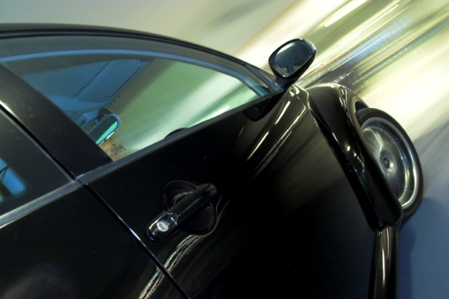
Advise guest of available services
Looking after dry cleaning needs
Organising personal driver, limousine, taxi or hire car
Arranging security.
Notes:
Trainer continues to provide trainees with examples of services a venue may be able to offer guests:
Looking after dry cleaning and laundry needs
Even where an internal facility exists and there are dockets in the room to enable guests to do it themselves many guests will ask the valet to take care of these requirements.
Some guests will stipulate where the items are to be cleaned (that is, using the in-house laundry or using an external provider) and how they are to be cleaned. Others will leave those decisions to the good sense and judgement of their valet.
Organising a personal driver, limousine, taxi, or hire car
From guest history it may be possible to ascertain guest preferences for a personal driver, limousine, taxi or hire car.
The phone number for these services will usually be listed in the guest’s history. If not, they can be obtained from the concierge.
Requirements in this regard can be for a one-off/single use time, or a day or week booking. Ensure relevant details are known relating to location of the car, times, numbers travelling and expected duration.
Arranging for appropriate security
Security may apply to items the guest wants stored in the establishment safe, or can apply to personal security required at their door (or on their floor), in their room, when they leave their room, and/or when they enter or leave the venue.
Where there are VIPs in the house it is standard practice for their floor/room to receive extra security attention.

Slide 86
Deal with guest luggage
When dealing with guest luggage:
Treat it with care & respect
Avoid damage & loss
Be aware your actions – and the actions
of others – are on public display.
Notes:
Trainer advises trainees that a standard requirement for all valets is to deal effectively with guest luggage highlighting important considerations are:
Treat all guest luggage with care and respect. The treatment of guest luggage can set the scene for the guest’s stay. If their luggage is not properly handled, they may believe they will not be properly handled
Avoid damage and loss. Luggage is expensive so deserves not to be damaged. The contents of many items are irreplaceable so attention must be paid to not forgetting an item of luggage or allowing it to be stolen
Realise luggage handling is on public show. The guest, their party and members of the public can easily see how the luggage is being treated and the care (or lack of it) being displayed.

Slide 87
Deal with guest luggage
When moving luggage to guest room or suite:
Two valets may be required
Take care
Organise ‘enough’ staff
Arrange for sufficient trolleys
(Continued)
Notes:
Trainer provides trainees with information relating to the movement of guest luggage to their room when a valet-serviced guest arrives at a venue:
Two valets may be used – one goes with the luggage (and porters) and the other stays with the guest, accompanying them to their room
Take care. Oversee the activities; ensure nothing is forgotten’ and ensure nothing falls off the trolley
Organise sufficient staff. Multiple porters are usually required to handle the relatively large volume of luggage VIP guests bring with them. Liaison with porters is essential when dealing with VIP guest luggage
Arrange for sufficient trolleys. If insufficient trolleys are available a plan detailing the sequence of luggage delivery to rooms must be created.

Slide 88
Deal with guest luggage
Obtain rooming sheets
Deliver VIP guest luggage first
Do not solicit tips
Luggage trolleys must be presentable
& fully operational
Porters must focus on luggage delivery.
Notes:
Trainer continues to provide advice to trainees regarding movement of guest luggage to their room on arrival:
Ensure rooming sheets are available and match luggage trolleys to each room being used by the VIP party. Each room must have its own trolley/s. Never try to accommodate luggage from different rooms on the same trolley
The VIP guest must be serviced first. The focus of delivering the luggage must be to get the bags to the primary guest before their retinue receives their luggage. When the main guest has had their luggage delivered, bags for the remainder of the party can be delivered
Gratuities are never solicited . Most VIP guests make an allowance for gratuities when they (or people on their behalf) settle their account on departure. Staff/porters will be advised during the staff briefing they are not to solicit gratuities
Luggage trolleys must be clean and in good condition
Porters must make VIP guest luggage delivery their priority . They cannot deal with other matters, provide service to other guests or take directions for other tasks.

Slide 89
Deal with guest luggage
When unpacking guest luggage:
Obtain keys to open cases
Check & clean luggage as you unpack
Place luggage on appropriate surface to
open & unpack
Remove all items from luggage.
Notes:
Trainer instructs trainees regarding the unpacking of guest luggage explaining the need to:
Obtain keys from guest to unlock bags. Advise guest immediately if there is evidence of tampering, or damage to cases or luggage
Check the outsides of the luggage and clean away any marks
Place luggage on an appropriate surface in the room to avoid damage. The luggage rack is the most common area to use
Remove all items from the luggage (subject to guest instructions) making sure all items are clean and dirty items are sent for laundering, or otherwise cleaned as appropriate

Slide 90
Deal with guest luggage
Place clothing in-room in an appropriate manner:
Using common sense
Applying house protocols
Following guest instructions.
Notes:
Trainer continues to instruct trainees regarding the unpacking of guest luggage explaining the need to:
Place clothing and items appropriately:
Drawers – jumpers, casual shorts, T-shirts, underwear. Ensure all clothes are neatly folded and stacked according to colour
Wardrobe – shirts, trousers, coats, suits, skirts, gowns
Hang similar items together – all suits together, all shirts together
The purpose of correctly hanging and folding clothes and other items is to keep the garments ready for use and wrinkle free.
Bottom of wardrobe – shoes:
Place aside shoes requiring attention
Position polished shoes in pairs and stack according to colour and occasions – for example casual shoes together, sports shoes together and formal shoes together.
Bathroom or make-up room:
Toilet bags
Make-up cases.

Slide 91
Deal with guest luggage
Comply with specific guest requests when unpacking which can include:
Cleaning of items
Ironing of clothes
Need to clean shoes
Use of suit & clothing bags
(Continued)
Notes:
Trainer continues to instruct trainees regarding the unpacking of guest luggage stressing the need to comply with specific guest requests which may include:
Sending clothing to be dry cleaned or laundered
Sending clothing to be pressed
Need for shoe care, cleaning or polishing
Hanging of suit and clothing bags in wardrobes or on hooks

Slide 92

Deal with guest luggage
Lint removal
Use of clothes hangers
Folding of items
Basic repairs.
Notes:
Trainer continues to give trainees examples of special instructions guests may give when valets unpack their clothes:
Brushing clothing to remove lint
Hanging individual clothes in wardrobes on appropriate hangers
Folding or re-folding clothes and placing in drawers
Providing or arranging basic clothing repairs such as sewing on of buttons, mending tears and stitching.
Class Activity – Individual Exercise
Trainer packs a variety of cases and asks trainees to:
Open and check the luggage, cleaning as required
Unpack/unload the luggage into appropriate locations in a simulated or actual guest room or suite.

Slide 93
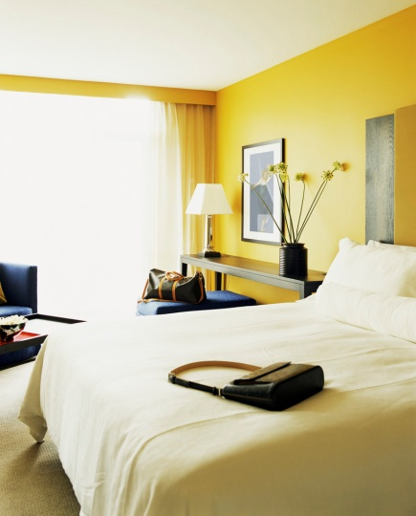
Deal with guest luggage
Dealing with unpacked luggage:
Follow guest preferences and requirements
Store in Luggage Room
Store in guest room or suite
Leave some in guest room & store some in Luggage Room
Store in other guest rooms – agent, manager
Luggage should be closed & locked when stored.
Notes:
Trainer explains to trainees guest luggage may be dealt with in a variety of ways once it has been unpacked but guest preferences and directions must always be complied with. Options for dealing with unpacked luggage include:
Removal of unpacked or empty luggage to the venue ‘Luggage Room’ using porters to do so and ensuring every item is tagged to identify the room it came from. This will facilitate retrieval of the correct items for the correct room when re-packing and departure time arrives.
Storing of unpacked or empty luggage in the guest’s room in designated luggage storage spaces. Suites and VIP rooms commonly provide specific areas where luggage can be stored in-room
Leaving nominated items of luggage in the room and taking other items to the Luggage Room
Moving empty items of luggage to rooms occupied by members of the guest’s entourage.
All luggage placed into storage should be closed and (where applicable) locked – as SOP.

Slide 94
Deal with guest luggage
If you identify damaged luggage as part of the unpacking process:
Advise guest immediately
Ask if repairs are required
Ask if replacement luggage is required
Determine requirements for following-up
on damage – cause & compensation.
Notes:
Trainer tells trainees luggage can become damaged during travel and part of the valet’s job is to deal with these situations. When they identify damaged guest luggage as part of the unpacking process they should:
Advise of the damage straight away so they are aware of it as soon as possible. Advice may be provided to the guest or their staff
Ask if the guest wants the luggage repaired or offer to have it repaired
Enquire if the guest wants a substitute item of luggage obtained. The valet may be required to purchase whatever is required
Liaise with the guest to determine if they require you to follow-up on the damage, for example, by contacting an airline and seeking compensation.

Slide 95
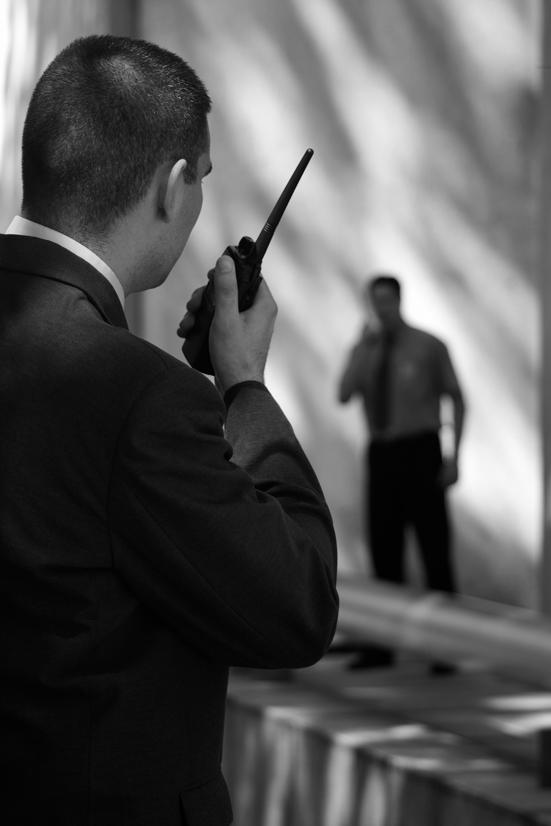
Deal with guest luggage
Security requirements when unpacking luggage:
Do not allow others to touch luggage
Restrict access to the area
Tell guest location of unpacked luggage
Check tags on bags
Verify locks on bags are working
Look for evidence of tampering.
Notes:
Trainer advises trainees that standard security protocols must be adhered to when dealing with guest luggage:
Never allow anyone apart from authorised people to handle or take items of luggage
Restrict access to areas where guest luggage is stored or being unpacked. Cose and lock doors to guest room or suite
Notify the guest or their staff as to where luggage has been taken for storage
Check tags on bags (as attached by guest or their staff) are intact. Take remedial action as necessary
Verify locks on bags are fully operational and advise where locks are damaged or missing
Look for evidence of tampering and advise where this is detected.

Slide 96
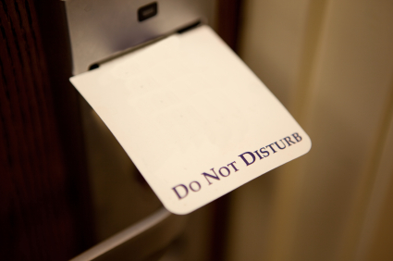
Deal with guest luggage
Be sensitive to:
Need to give guests privacy as soon as possible
Need for some guests to unpack all their
own bags
Need for some guests to unpack
certain of their own bags.
Notes:
Trainer instructs trainees that there is a need for sensitivity when unpacking guest luggage as guests have just arrived and may be tired and irritable:
Never force guests to receive valet service – it is their decision about what occurs, not the valet’s decision
Work quickly – allow guests private time as soon as possible
Some guests will want to unpack all their bags – allow them to do so
Some guests will want unpack bags containing their personal items but will be happy for valets to unpack the other bags
Be aware guests may not be at their best when they have just arrived after a long trip and are surrounded by people they do not know.

Slide 97

Deal with guest clothes
Dealing with guest clothes may involve:
Preparing clothes
Pressing clothes
Repairing clothes
Cleaning clothes
Cleaning footwear
Purchasing clothes & footwear.
Notes:
Trainer states to trainees that a major part of delivering valet services is the need to deal with guest clothes reminding them guest requirements and preferences must be complied with at all times.
Trainer advises trainees this large section will look at:
Preparing guest clothes including laying it out ready for wear
Pressing guest clothing
Repairing clothes
Cleaning clothing
Cleaning footwear
Purchasing items for the guest – clothing and footwear.

Slide 98
Deal with guest clothes
When preparing guest clothing:
Follow guest advice or direction
Check all items are presentable
Lay the items out
Compliment the guest on their choice
and appearance.
Notes:
Trainer provides instruction to trainees regarding the preparing of guest clothing:
Follow guest advice and/or instruction about what they want to wear. The more advice/direction the guest gives in this regard, the better
Ensure all items are presentable – clean, tidy, pressed, no rips or tears, no missing buttons, no loose stitches, no loose hems, no marks or stains
Lay out the items so the guest knows what has been selected or prepared for them and can quickly dress
Compliment the guest on their appearance and on their choice of clothes.

Slide 99
Deal with guest clothes
Pressing guest clothes = Ironing guest clothes.
Before you press any guest clothes:
Obtain instructions on how to iron
Practice.
Notes:
Trainer provides instruction to trainees regarding the pressing of guest clothing recommending before they undertake this task for a guest they must:
Receive instruction – from senior and experienced laundry staff in the venue
Practice – so you gain confidence and competence.

Slide 100
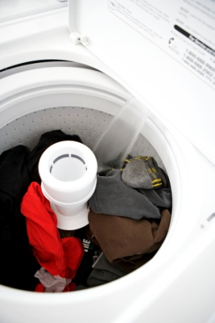
Deal with guest clothes
Three basic options for pressing guest clothes:
Valet irons them, in-room
Items are sent to on-premises laundry
Laundry staff come to guest room & press
them in-room.
Notes:
Trainer explains to trainees there are three options available for ironing/pressing guest clothes:
The valet irons clothes in the guest room using a standard iron and ironing board with all the necessary accompaniments such as spray bottles for starch and water, and lint removing brushes
Items are sent to the laundry for ironing. This is commonly only done where there are large quantities of clothing to be pressed or where the items require the use of special bucks
Laundry staff come to the guest room and iron the clothes in the room using specialist equipment and products as required.
Class Activity – Major Excursion
Trainer arranges for trainees to visit a venue where valet services are provided.
Trainer should arrange for trainees to:
Talk with Management and valets about the provision of valet service
Observe valets or other staff in a real or simulated situation:
Preparing room for VIP guest
Handling guest luggage and unpacking luggage
Ironing guest clothes
Cleaning guest shoes
Preparing guest clothes
Packing guest luggage.

Slide 101
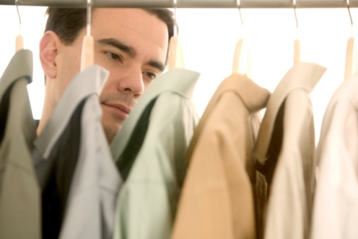
Deal with guest clothes
When ironing guest clothes:
Shake them out before ironing them
Read ‘care labels’
Never iron directly onto a hard surface.
Notes:
Trainer presents trainees with basic pressing tips :
Shake clothes out before starting to iron them
Iron on an underliner
Check ‘care labels’ on clothing before ironing.
Class Activity 1 – Handouts
Trainer obtains a range of care labels and presents same to class:
Explaining their contents
Indicating where they are located on items
Stressing the importance of reading and following them.
Class Activity 2 – Online research
Trainer provides class with internet access and asks them to:
Access the following sites
Watch the videos and take notes.
http://www.youtube.com/watch?v=5MnHirHxqkA
http://www.youtube.com/watch?v=T5PU5S_U_8c
http://www.youtube.com/watch?v=f_3qWYcpxD4
http://www.ehow.com/video_4791107_quick-easy-tips-ironing-clothes.html

Slide 102
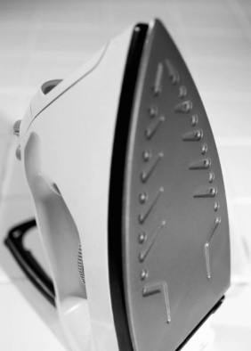
Deal with guest clothes
Check iron is clean
Set iron to correct temperature
Use ironing aids or chemicals as appropriate.
Notes:
Trainer continues to provide advice to trainees regarding pressing of guest clothes:
Check the iron and the ironing surface is clean before use
Set the iron to the correct temperature/setting. A common mistake when ironing is to have the iron too hot which can damage clothes
Use ironing aids or chemicals as appropriate – spray starches, and/or water.
Class Activity 1 – Demonstration
Trainer demonstrates to trainees how to press a variety of guest clothing such as:
Trousers
Skirts
Shirts
Blouses
Frocks
Suits.
Note: Trainer may use a Guest Speaker to provide this demonstration, such as an experienced valet or a Laundry worker.
Class Activity 2 – Individual Practice
Trainer arranges for ironing boards, irons, ironing accompaniments and clothes to be available for trainees to practice ironing of:
Trousers
Skirts
Shirts
Blouses
Frocks
Suits.
Trainer assesses trainee finished products and provides constructive feedback.

Slide 103
Deal with guest clothes
When repairing guest clothes:
Look for things requiring repairs
Make small repairs yourself
Make arrangements for bigger repairs:
Internally
Externally.
Notes:
Trainer provides trainees with advice regarding the provision of repairs for guest clothes, stating:
Be proactive. Do not just wait for guest to ask for repairs to be done: look for items requiring attention and take appropriate action
Make small repairs using a valet kit to sew on buttons, stitch a hem
Arrange for larger repairs as opposed to actually undertaking them. Repairs may be:
Done internally by the laundry or seamstress
Sent outside where specialist work is required using preferred suppliers/providers.

Slide 104
Deal with guest clothes
Cleaning of guest clothes:
Guest may require laundering and/or dry cleaning
May involve internal and/or external services
Count & record the items to be cleaned
Identify special attention required
Identify & record damage
(Continued)
Notes:
Trainer provides direction to trainees regarding tasks associated with arranging the cleaning of guest clothes highlighting that cleaning may entail laundering (washing, ironing and folding) or dry cleaning, and guests may specify in-house treatment of their clothes or external treatment. Tasks involved include:
Counting and recording the items to be laundered/dry cleaned
Identifying special attention required such as:
Stains requiring treatment – identifying the cause of the stain if possible
Repairs
Requirements of the guest which may, for example, stipulate ‘hand washing’, the use of certain chemicals or a prohibition on the use of certain chemicals
Identifying and recording of pre-existing damage or problems with the garments prior to treatment so the venue is not held responsible for causing these problems.

Slide 105
Deal with guest clothes
Check the pockets
Check the garments
Complete documentation
Arrange for pick-up of items for treatment
Specify time required for return of items.
Notes:
Trainer continues to tell trainees about tasks involved in arranging cleaning of guest clothes:
Checking pockets to remove any items left in pockets
Checking the garments to look for and remove anything attached to them such as brooches, name tags, ornaments
Completing internal documentation requesting laundry and/or dry cleaning. This documentation forms the basis of charging the guest for services provided in this regard
Arranging for collection of the items or delivering the items to the laundry
Specifying time required for items. A VIP guest using a valet receives preferential treatment in terms of the priority afforded to their clothes to be cleaned or repaired.
Class Activity – Guest Speaker
Trainer arranges for an experienced Laundry Worker to attend and talk to trainees about:
How valets should address the cleaning of guest clothes including action they should take to assist the laundry
Details the laundry requires or needs to obtain in order to clean guest clothes
Problems associated with meeting unreasonable requests and identification of unreasonable cleaning requests
Identification of items the laundry will refuse to process.

Slide 106
Deal with guest clothes
When cleaning guest shoes:
Ensure you have been trained in house techniques for cleaning various shoes
Practice
Use guest materials when necessary
Clean the brushes
Keep cleaning materials together
(Continued)
Notes:
Trainer advises trainees about the cleaning of guest shoes:
Obtain house training. This is important because the venue may be liable if the shoes are damaged during the cleaning process so most venues have their own way of cleaning shoes
Practice to gain competence and confidence
Use polishes and brushes belonging to the guest when asked to do so or when cleaning or polishing shoes made from unusual material
Clean the brushes after every use, and check them before use to avoid transferring colour from shoe to shoe
Keep cleaning aids together for easy access.
Class Activity – Online research
Trainer provides class with internet access and asks them to:
Access the following sites
Watch the videos and take notes.
http://www.youtube.com/watch?v=_U7Os0S_I7k
http://www.videojug.com/film/how-to-clean-suede-shoes
http://www.youtube.com/watch?v=IeScJ_Hemno

Slide 107
Deal with guest clothes
Use a shoe tree for leather shoes
Remove dirt
Remove laces
Apply polish & buff the shoes
Check & replace laces.
Notes:
Trainer continues to give trainees advice regarding cleaning of guests shoes:
Use a shoe tree for leather shoes every time. Realise polishing guest shoes is not the same as doing own shoes
Remove laces before starting to clean and before applying polish. Note the way shoes are laced as they will need to be re-laced in the same way when cleaning has been completed
Apply polish and polish the shoes using brush or cloth in accordance with house protocols or specific advice from guest
Check laces before replacing them. Fit new laces where required or where old laces show signs of wear. Re-lace the shoes in the same way.
Class Activity 1 – Demonstration
Trainer demonstrates to trainees how to clean and polish a variety of shoes such as:
Leather shoes
Suede shoes
Sports shoes.
Note: Trainer may use a Guest Speaker to provide this demonstration, such as an experienced valet.
Class Activity 2 – Individual Practice
Trainer arranges for necessary cleaning materials and other items to be available for trainees to practice cleaning and polishing of:
Leather shoes
Suede shoes
Sports shoes.
Trainer assesses trainees’ finished products and provides constructive feedback.

Slide 108
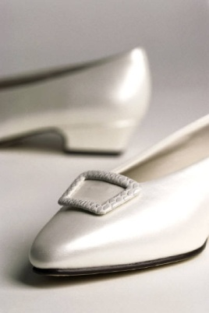
Deal with guest clothes
When buying clothes/shoes for a guest:
Obtain as much information as possible about what is required
Obtain a sample or a photograph
Does guest have preference for shops
and/or brands?
Identify amount to be spent
(Continued)
Notes:
Trainer gives trainees advice regarding purchasing of clothing and shoes on behalf of a guest:
Obtain as much information from the guest as possible about what is required (as appropriate to the item) – style, size, colour, materials, patterns, sleeves or no sleeves
Where possible obtain a sample of what is required. For example you may be able to obtain:
The damaged item that needs to be replaced – this will give an exact indication of what is required
A similar item in a different colour which can provide guidance relating to style and size
A photograph of what is required
Determine if guest has a preference for shops to be used and/or brand names to be bought. Where the guest has no preference, use your initiative and buy ‘known’ labels
Identify the amount the guest wants to spend. There is nearly always a limit.

Slide 109
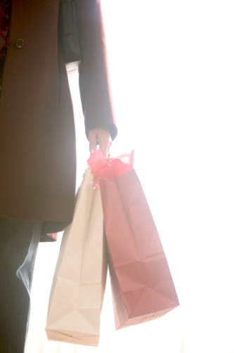
Deal with guest clothes
Try to get suppliers to come to guest room to display items
Ensure suppliers will take items back if they are not what is required
Obtain multiple items ‘on approval’
Keep all receipts.
Notes:
Trainer continues to give trainees advice regarding purchasing of clothing and shoes on behalf of a guest:
Only deal with shops or suppliers who:
Are prepared to come to the venue and make a presentation to the guest so they can see the items first-hand and make a choice. This demonstrates high levels of service and removes the responsibility from you of having to make a decision on their behalf
Are prepared to sell the items on the basis they can be returned if the guest does not like them – for a full refund
Will allow multiples of items to be taken ‘on approval’ . For example, you may want to take the one style of garment in a range of different colours, or you may want to take to show the guest a range of different styles (or sizes) for the item they were seeking
Keep all receipts and accompanying paperwork to prove amounts spent and indicate where items were purchased, and when.

Slide 110

Deal with guest clothes
Disbursements = money paid by the venue for purchases on behalf of the guest:
Means valets can buy items for guest without need for cash from guest
Money is recouped from guest through charges to their account
Disbursements can be made for flowers,
taxi fares, tickets, clothes.
Notes:
Trainer informs trainees in many cases the venue pays for clothing bought by guests and then recoups this money by charging the items to the guest’s house account meaning there is rarely a need to obtain cash or a credit card to make purchases on behalf of the guest:
Payments made by the venue on behalf of guests are called ‘disbursements’.
Commonly disbursements cover small to medium size expenditures only such as:
Taxi fares
Flowers
Theatre tickets.

Slide 111

Deal with guest requests
In relation to requests from guests:
Never do anything illegal
Never put personal safety at risk
Never agree to do anything which would
damage equipment or property.
Nothing is too much trouble!
Notes:
Trainer mentions to trainees while guests are staying at the venue they can make a limitless number and type of requests to their valets highlighting they must:
Never do any illegal act –or anything bordering on being illegal, or which would bring disrepute to the venue or the guest
Never put themselves at risk or put the safety of guests, others, or members of the public at risk
Never do anything which could result in damage to venue property or the property of others.
Trainer advises trainees within these boundaries valets must adopt the position ‘nothing is too much trouble for their guests’.

Slide 112
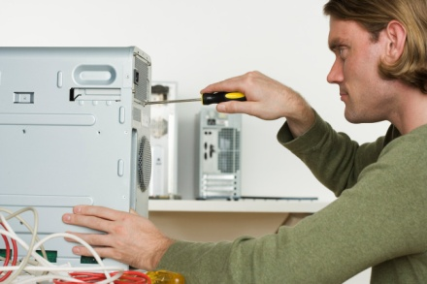
Deal with guest requests
Organising repairs to items on behalf of guests:
Do so when asked and look for items needing repair
Use external (‘preferred’) providers
Identify monetary limit to spending
Determine when guest needs the item
Get things moving.
Notes:
Trainer states to trainees they may be required to organise repairs for guests and important aspects to consider in this respect are:
Arrange repairs when asked to do so and also be on the lookout to identify items requiring repairs and either ask for permission to have the repairs done, or be proactive and go ahead and arrange for them to be undertaken. House rules and the nature of your relationship with the guest will indicate which course of action is best.
Use external service providers as opposed to internal maintenance staff. This allows maintenance to continue with their scheduled work and relieves the venue of any legal obligation attaching to repairs provided. Use known or ‘preferred providers’ – or businesses indicated by the guest. In some cases you will have to use businesses who are accredited dealers or repairers.
Ask the guest if there is a limit to how much they want to spend on repairing the item and whether or not they want a new or replacement item purchased. It can also be useful to ask if the guest requires an item to replace the one that is being repaired. You may be required to obtain a quotation for the work to be done before authorising the repairs.
Determine when the guest needs the item. This should be passed on to the repairer indicating any urgency accompanying the need for the repairs. Where the repairer is unable to meet these time-related demands the guest must be immediately notified so they can make appropriate decisions based on this feedback or information.
Get things moving. You must immediately arrange for the item needing repairs to be taken to the appropriate business, or for it to be collected as soon as possible from the venue. You, or other venue staff, may need to personally take the article where it needs to go.

Slide 113

Deal with guest requests
When making bookings for guest:
Obtain necessary guest details – destination, time, numbers, budget & preferences
Contact business & make enquiries/bookings, confirm reservations, pay & obtain documentation
Forward documentation – to guest, support
staff and/or venue accounts department.
Notes:
Trainer states to trainees that guests commonly require valets to make bookings (for travel, accommodation, theatre, dining, excursions and tours) indicating steps in the process are:
Obtain necessary detail from the guest, advising or making recommendations and suggestions as appropriate:
Destination, trip, tour or business
Dates/s and time/s
Number of reservations required
Budget
Preferences – for seating, travel, options: always try to obtain a second preference in case the first choice is unavailable
Contact necessary businesses to enquire and:
Make bookings as required – if possible
Confirm reservations – repeating/verifying booking details
Pay for reservations – where necessary: ensure relevant discounts and commissions are obtained
Obtain documentation – if relevant
Forward documentation (receipts, confirmations, associated terms and conditions, seating allocations) where appropriate:
To guest for their use and reference:
Explain variations to original requirements if applicable
Verify details of the reservation
To accounts department to enable charges for bookings to be claimed back from guest where reservations have included payment by the venue on behalf of the guest.
In some cases, the guest will ask for reservations which will be difficult to make. In these cases, the influence of the venue and the personal contacts of the Concierge are used to maximise the effort made on the guest’s behalf.

Slide 114

Deal with guest requests
Other requests may include:
Making sundry purchases
Responding to unusual circumstances
Arranging for room service.
Notes:
Making sundry purchases
Items may be purchased from in-house shops or departments or from outside business (specialist suppliers). Purchases from internal shops or departments are commonly charged directly to the guest’s account. Sundry purchases from external businesses are usually handled as a disbursement being charged to the venue account, or paid for in cash or by credit card. Charges are then re-couped from the guest.
There is no end to the list of sundry items a guest may require a valet to purchase. Examples include:
Flowers
Gifts
Special need items – such as items the guest has forgotten, and/or replacement items for damaged or lost property.
Responding to unusual circumstances
The valet is also usually the first point of contact for the guest when an ‘unusual circumstance’ occurs and there is a need to address it. While the valet is not expected to personally deal with all of these situations, they are expected to notify others so they can deal with the situation. For example:
A complaint from the VIP guest about noise in an adjoining room. The valet would contact Management, Front Office or Security to handle the noise, as opposed to knocking on the door and asking people to modify their behaviour
A situation where an item in the room is not working. The valet would contact Housekeeping to arrange for a replacement item, or contact Maintenance to undertake repairs. The valet would not be expected to fix the item.
In all ‘unusual circumstances’:
The safety of the guest, their party and the valet is the primary consideration
The security of guest and venue property is a secondary concern
Immediate action must be taken to address the situation and notify the appropriate person, department or external authority
House policies and procedures must be implemented, for example as they apply to dealing with ‘Difficult guests’, ‘Security breaches’, or ‘Evacuation’
The guest (or their representative) must be kept advised of what action has been taken to address the situation and what will occur as a result.
Arranging for room service
This can relate to the service of snacks and drinks, the ordering and service of a full meal in the room for the guest and their party, and/or the provision of small in-room functions.
The valet may be required to:
Advise on what is available
Relay the order to Room Service
Assist with the service of items ordered – or this may be the sole job of Room Service staff

Slide 115

Deliver enterprise-specific VIP treatment & services
All valet-serviced guests are VIPs who get special treatment & services:
They do not have to request the VIP services & treatment – they are provided automatically
VIP treatment may or may not extend to their party
Types & nature of VIP service varies
between venues
Valet-serviced guests are usually advised
in advance of the VIP treatment they
will receive.
Notes:
Trainer advises trainees all guests who receive valet service are regarded by venues as VIP guests and merit special treatment and services, explaining:
Guests do not have to ask for the special treatment and services in order to receive them. Naturally if the guest especially requests they not be provided, they must not be provided
Treatments for the VIP may or may not extend to members of the VIP guest party – by arrangement and/or in accordance with directions from the guest or house policies and procedures
Treatment offered to and services provided for VIPs will vary between venues due to:
Cost – in most cases the venue seeks to show a profit from a stay by a VIP so the nature and extent of special treatments and services is restricted by either the price charged for the room, or the cost charged for the valet. In some cases, the venue may be prepared to ‘break even’ (or even show a small loss) where the presence of the VIP generates business from other sources and/or creates valuable media attention.
Physical resources available – a venue is unlikely to spend money buying materials and equipment just to service a one-off VIP guest’s requirements
Ability of staff – venues traditionally operate using the staff they have and therefore can only function within the expertise and capabilities of those people. It is rare – but not unknown – for venues to ‘fly in’ extra staff just to provide VIP services
Time constraints – this is a major cause of difference. Where the guest has limited time or is on a tight schedule the capacity of the venue to deliver certain services and treatments is severely restricted.
Commonly, a VIP will be advised (verbally and in hard copy form) of the special treatment they can expect to receive. This means they have certain expectations about their VIP status when they arrive so it is vital valets meet these expectations.

Slide 116

Deliver enterprise-specific VIP treatment & services
VIP treatment & services for valet-serviced guests may include:
Provision of turn down service
Provision of fruit basket
Provision of confectionaries
(Continued)
Notes:
Trainer identifies to trainees that it is possible the following may be made available to VIP guests.
Provision of turn down service where house protocols are followed such as:
The bed is turned down, a mat is laid next to the bed and slippers and robes are laid out
Curtains are closed
Lights are turned on
A chocolate or similar is presented on the pillows
The room is serviced.
Provision of fruit basket/s. This is:
Often already in the room when the guest first arrives or may be delivered shortly after they arrive
Accompanied by a ‘With Compliments’ card
Refreshed throughout the duration of the guest’s stay as items are used.
Provision of confectionaries. This may include:
Items requested by the VIP when the booking was made
Quality, wrapped chocolates
Petit fours and/or canapés prepared at the venue.

Slide 117
Deliver enterprise-specific VIP treatment & services
Preferential treatment within the venue
Preferential seating and booking privileges
Provision of valet parking
(Continued)
Notes:
Trainer continues to present to trainees examples of VIP treatment and services which may be delivered to a valet-serviced guest:
Preferential treatment. Because the guest is a VIP, is paying top rates and is usually influential, they always receive preferential treatment for everything they want. It is the valet’s job to ensure, for example that Room Service, the Kitchen, Housekeeping and other departments as necessary are advised an order or request is for a VIP thereby indicating the preferential treatment to be provided. Preferential treatment may include:
All food and beverage orders are given first priority even before other existing orders
Provision of extra items when a product or service is being delivered:
Services are usually provided for a longer time period than normal
Larger serve sizes
Supplementary products to enhance presentation and/or service delivery.
Preferential booking and seating privileges in the venue – this may mean:
The restaurant/dining areas automatically reserve the best seats/table for VIPs when a reservation for rooms is taken – even though there is no definite indication the VIP guest/party will eat in-house. Other guests who have reserved the best seats/tables are bumped to other seats/tables so the VIP can have their seat/table
Special table set-up – for example candelabra as well as better quality crockery, cutlery and glassware
Allocation of the most competent and knowledge service staff to their table/s
Notification to the Kitchen regarding attendance of the VIP/s.
Provision of valet parking. This service may be supplied to all guests or be reserved only for VIPs. It is often not the valet who actually provides the valet parking services. Valet parking involves:
Taking the guest car/s once they have arrived and after every subsequent arrival at the venue after they have been elsewhere and returned
Parking them in a secure location ensuring ready availability
Recovering and returning the vehicle on request, parking it in a designated and easily accessible location
Detailing (cleaning and polishing) the vehicle/s, making sure they look clean and polished
Noting mechanical problems with the vehicle and notifying the guest
Monitoring service requirements and arranging for same in consultation with the guest.

Slide 118
Deliver enterprise-specific VIP treatment & services
Provision of escort or guide
Provision of additional rooms.
Notes:
Trainer continues to present to trainees examples of VIP treatment and services which may be delivered to a valet-serviced guest:
Provision of escort or guide. VIPs may be provided with a local person with high levels of knowledge about the local area, local customs and culture to enhance the guest stay and help with shopping, local tours, general knowledge, and introductions (to individuals and businesses). Where the guest is from a non-English speaking country, this person will always be bilingual speaking both the language of the country being visited, and being fluent in English so they can act as interpreter and communicate effectively. This person is not the valet but may be organised by the valet, or Concierge.
Provision of additional rooms. Venues (and the valet) must be alert to the potential for VIP guests to need additional rooms when they are staying in a venue. Standard practice is to ask the guest whether they will require additional rooms when the initial reservation is received. Often the need for such rooms can occur on the spot in which case it is up to the valet to arrange what is required with Front Office, Housekeeping, security and other departments as appropriate. Additional rooms may be required for:
Media events and press conferences
Parties and functions
Business uses such as meetings, conferences, and presentation of products.

Slide 119
Adjust service delivery to suit guest needs & preferences
Adjusting service delivery to VIPs
The keys are:
Identify required changes
Advise relevant people of need to adjust
Monitor changes to service or product delivery
Take further corrective action as, or if, required.
Notes:
Trainer stresses to trainees that guests receiving valet service have a right to have service delivery adjusted to suit their individual needs as part of their VIP treatment.
Trainer highlights to trainees that it must always be remembered the venue and the valet and all other venue staff are there to serve the guest, not to dictate the service provided. The keys to achieving this are:
Identify the necessary/required changes – make sure to never show annoyance or frustration with the required changes
Advise those necessary for delivering the products/services needing to changed – make sure they know the changes are for a VIP/valet-serviced guest
Monitor revised service/product delivery to ensure it meets requirements
Take further corrective action when necessary including apology to the guest.

Slide 120

Adjust service delivery to suit guest needs & preferences
Changes may be required for:
Wake-up & reminder calls
Breakfast arrangements
Transportation arrangements
(Continued)
Notes:
Trainer explains to trainees the possible list of things that may need amending to accommodate valet-serviced guest need is limitless. Anything for which plans or arrangements were originally made may need to be adjusted:
Changes to original notifications (times) for:
Warning (reminder) calls
Wake-up calls
Changes to breakfast arrangements in relation to:
Style – English, Continental or local
Time of service
Items ordered
Whether the breakfast will be in-room, outside or in the dining room
Changes to transportation arrangements in relation to local trips and tours as well as forward travel plans. Common changes are required to:
Dates and times
Destinations including stop-overs
Numbers travelling.

Slide 121
Deal with guest requests
Other requests may include:
Making sundry purchases
Responding to unusual circumstances
Arranging for room service.
Notes:
Making sundry purchases
Items may be purchased from in-house shops or departments or from outside business (specialist suppliers). Purchases from internal shops or departments are commonly charged directly to the guest’s account. Sundry purchases from external businesses are usually handled as a disbursement being charged to the venue account, or paid for in cash or by credit card. Charges are then re-couped from the guest.
There is no end to the list of sundry items a guest may require a valet to purchase. Examples include:
Flowers
Gifts
Special need items – such as items the guest has forgotten, and/or replacement items for damaged or lost property.
Responding to unusual circumstances
The valet is also usually the first point of contact for the guest when an ‘unusual circumstance’ occurs and there is a need to address it. While the valet is not expected to personally deal with all of these situations, they are expected to notify others so they can deal with the situation. For example:
A complaint from the VIP guest about noise in an adjoining room. The valet would contact Management, Front Office or Security to handle the noise, as opposed to knocking on the door and asking people to modify their behaviour
A situation where an item in the room is not working. The valet would contact Housekeeping to arrange for a replacement item, or contact Maintenance to undertake repairs. The valet would not be expected to fix the item.
In all ‘unusual circumstances’:
The safety of the guest, their party and the valet is the primary consideration
The security of guest and venue property is a secondary concern
Immediate action must be taken to address the situation and notify the appropriate person, department or external authority
House policies and procedures must be implemented, for example as they apply to dealing with ‘Difficult guests’, ‘Security breaches’, or ‘Evacuation’
The guest (or their representative) must be kept advised of what action has been taken to address the situation and what will occur as a result.
Arranging for room service
This can relate to the service of snacks and drinks, the ordering and service of a full meal in the room for the guest and their party, and/or the provision of small in-room functions.
The valet may be required to:
Advise on what is available
Relay the order to Room Service
Assist with the service of items ordered – or this may be the sole job of Room Service staff

Slide 122
Adjust service delivery to suit guest needs & preferences
Function requests/arrangements
Changes to in-room furniture
Special requests for bar & beverage items
Eliminating nominated aspects of standard
service provision at guest request.
Always advise other personnel or departments of requirements where they are responsible or involved in service delivery.
Notes:
Trainer continues to identify for trainees examples of service delivery that may need to be adjusted for valet-serviced guests:
Changes to function requests in relation to:
Food and drink
Numbers
Seating plans
Sequence and timing of function-related issues such as arrival of guests, speeches, entertainment
Changes to in-room furniture:
Removal of items not wanted by the guest
Introduction of additional items or furniture to meet specific needs
Provision of replacement items to address broken, damaged or malfunctioning items.
Meeting special requests for bar and food items. This may be for:
Products for the in-room bar/mini-bar
In-room meals
Eliminating nominated aspects of standard service. It is possible the guest may not want to be provided with some standard aspects of service so be alert to this possibility and respond accordingly by only providing what is required.
Some changes may involve other departments and the valet will need to inform relevant departments immediately of any changes.

Slide 123
Maintain guest privacy & confidentiality
Guest privacy refers to their right to:
Enjoy their personal space & freedom while at the venue
Be free from unwanted attention,
interference and/or observation by others.
Notes:
Trainer advises trainees these slides extend and reinforce earlier information provided on privacy and confidentiality.
Trainer states to trainees that guest privacy refers to the right of the guest to:
Enjoy their personal space and freedom in their room and elsewhere at the venue
Be free from attention, interference and observation by other guests and/or members of the public.

Slide 124
Maintain guest privacy & confidentiality
To optimise guest privacy:
Enquire when and if guests want to be left alone
Never tell others where VIPs are staying
Never let anyone into VIP guest room
Divert their telephone when they
want privacy
Liaise with Security staff when
necessary.
Notes:
Trainer suggests to trainees they should apply the following to optimise guest privacy:
Enquire when guests wish to be left alone and comply with these requirements. Valets are not required to be with the guest 24 hours a day, 7 days a week. Guests may wish time to themselves or require privacy to meet with business colleagues or spend with friends and/or family. Some guests require privacy at regular times each day, and other guests will request it as they feel the need arises. Guests commonly request privacy shortly after they have checked in and been roomed.
Never disclose the location or room number of guests to anyone
Not allow others to enter the guest room/s. This includes preventing other staff entering rooms at times when the guest indicates they wish their privacy
Divert the room telephone at times when the guest wishes privacy
Liaise with other staff such as:
Security who may man the door to the room to prevent unwelcomed access or intrusion
Housekeeping who may delay or re-schedule room cleaning and other associated activities
Front Office who will hold deliveries rather than deliver them to the room.

Slide 125
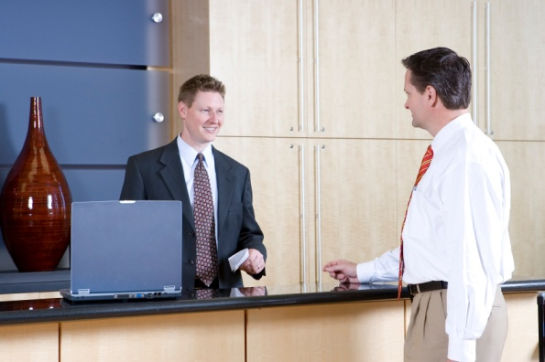
Maintain guest privacy & confidentiality
To maintain guest confidences:
Never repeat anything you hear from the guest
Never reveal anything you see in a
guest room
Never ‘confirm’ or ‘deny’ anything
relating to a guest.
If you breach guest privacy or confidentialities you may be sacked and/or sued.
Notes:
Trainer explains to trainees confidentiality means keeping matters to do with the guest to themselves, meaning they must:
Never repeat anything heard from the mouth of the guest to anyone
Never reveal anything seen in the guest room to anyone unless it relates to illegal activity in which case Management are the only ones to be advised
Never confirm or deny anything asked by others or by the media.
Class Activity – Role Play
Trainer plays the role of a guest (or media person) making enquiries about a VIP guest.
Trainee plays role of valet responding to these requests.
Remainder of class observes the role play.
Debriefing occurs at the end of the role play with feedback provided to trainees on their performance.

Slide 126
Assist guests with pre-departure & on-departure services
On-departure valets will be expected to:
Facilitate check-out
Pack luggage
Arrange luggage pick-up from rooms
Arrange to forward items to guest
Arrange accommodation.
Notes:
When a VIP guest is preparing to leave the venue and travel on, or return home, the valet will be engaged in a series of predictable tasks:
Facilitating check-out – covered on next slide
Packing – covered on subsequent slides
Arranging for luggage pick-up – also covered on subsequent slides
Arranging to forward items – also covered on subsequent slides
Arranging accommodation – covered to an extent already but also covered again on subsequent slides.

Slide 127
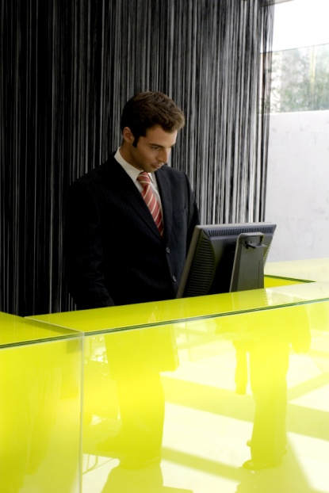
Assist guests with pre-departure & on-departure services
To facilitate guest check-out:
Identify who will finalise the account
Liaise with Front Office regarding the
preparation of the final account to ensure
all charges have been included on
the account
Determine how the account will be
presented and who will present it.
Notes:
Trainer provides trainees with direction about what valets should do to facilitate guest check-out when they are due to depart:
Identify who will finalise the account. This finalisation requires them to check the charges made to the account, approve them for payment and pay the account. For many valet-serviced guests it is often a Manager, agent or staff member who will do this. Ensure to the best of your ability that all legitimate charges have been added to the guest account so the venue recovers all revenue to which it is entitled
Liaise with Front Office regarding preparation and production of the final account. This can mean verifying charges listed and/or clarifying matters where there is confusion over charges and whether or not they should be included on the account. It is important a positive guest stay is not marred by argument over the charges applying to the stay when the guest departs.
Determine who will present the account to the nominated person who will finalise the account. VIP guests are commonly not required to check-out in the ‘normal’ way at Front Office. The account is usually presented in person to the guest (or their representative) in their room by venue Manager or Duty Manager, or the Head Receptionist. Where the valet presents the account, they must have a delegated scope of authority to waive charges (of certain types and/or to nominated amounts) if there is a query from the guest.

Slide 128
Assist guests with pre-departure & on-departure services
When packing guest luggage:
Obtain empty luggage to pack into
Comply with guest requests in this regard
Determine what needs to be packed and the luggage available
Guests will nearly always want to pack
some items and/or bags themselves
Fold clothes according to house protocols.
Notes:
Trainer provides guidelines for trainees to follow when packing guest luggage prior to their departure:
Liaise with porters (and/or Housemen) to arrange return of empty suitcases and bags to the guest room
Sometimes this is not required as the guest or their staff or partner will perform this task. A general ‘rule of thumb’ is if the guest required their luggage to be unpacked, they will want it packed on departure
Do not start packing until there is full knowledge of everything needing to be packed together with the bags/luggage available to pack into. When unsure, ask the guest what needs to be packed and what luggage they have to pack items into. Even where you have been asked to pack for guests, they may nonetheless want to pack and carry some things themselves.
Fold clothes according to venue requirements and procedures. Some properties have instructions on how they want items folded and packed. Always make sure proper venue-based training has been received first before actually packing guest clothes. Also ask a more experienced valet to help the first several times packing of guest luggage is undertaken.
Class Activity – Internet Research
Trainer provides internet access to trainees and asks them to visit the following sites (and any other relevant websites), watch the videos and take notes:
http://www.howdini.com/howdini-video-7257769.html
http://blog.suitupp.com/2009/10/04/how-to-neatly-pack-your-suitcase-suits-pants-socks-shirts-ties-belts-for-men/

Slide 129
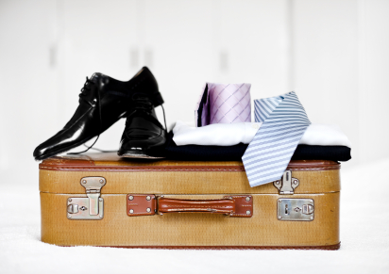
Assist guests with pre-departure & on-departure services
When packing:
Pack shirts in folded pairs
Place garments facing to front & top of suitcases
Put shoe trees into shoes
Put shoes in plastic bags with soles
flat against sides of luggage
Put heavy items at bottom
Cover everything with a towel.
Notes:
Trainer suggests to trainees where no venue-specific advice or help about packing luggage exists, the following should apply:
Pack shirts in folded pairs – reversed and toward each other
Pack the front of garments toward the front and top of the luggage
Place shoes into plastic bags – inserting shoe-trees as appropriate
Pack shoes with the soles flat against the sides of the luggage. Pack into plastic or shoe bags before packing into suitcases
Pack luggage with heavy items at the bottom and lighter items on the top
Complete the packing with a towel to cover all items.
Class Activity 1 – Demonstration
Trainer demonstrates to trainees how to pack a selection of items into a range of suitcases/bags.
Note : an experienced valet may be used as Guest Speaker to demonstrate this task.
Class Activity 2 – Personal Practice
Trainer provides a range of guest items (including clothing and shoes) and a range of guest luggage (suitcases and bags) and:
Requires trainees to pack designated items into designated luggage
Observes trainees undertaking this task
Provides ongoing feedback on progress and feedback when the luggage has been packed.

Slide 130
Assist guests with pre-departure & on-departure services
Arranging for valet-serviced luggage to be collected from the room involves:
Liaising with porters to obtain empty cases
Organising staff to collect packed luggage
Indicating where luggage is to be taken
(Continued)
Notes:
Trainer advises trainees as part of the departure process for valet-serviced guests, they may be required to arrange for luggage pick-up, which may require them to:
Organise staff to remove packed cases:
Specify time for cases to be collected
Identify number of cases or number of trolleys required
Identify room number/s
Indicate where luggage must be taken, for example:
Direct to guest cars in the parking area, or out the front of the venue
To luggage holding bays for later transport to coaches, cars or limousines or taxis.

Slide 131
Assist guests with pre-departure & on-departure services
Removing existing baggage/luggage tags
Arranging new luggage tags
Double-checking all cases and bags are
secure – closed & locked.
Always check the room after luggage has been collected to look for ‘forgotten’ items
Notes:
Trainer continues to identify the tasks involved when valets organise luggage pick-up from guest rooms:
Remove existing luggage tags and/or airline tags from individual items
Arrange luggage tags on behalf of the guest featuring their name and a contact
Double-check all cases and bags are secure – closed, locked and otherwise secured in accordance with individual guest requirements

Slide 132
Assist guests with pre-departure & on-departure services
Before guest departs:
Obtain a forwarding address
Obtain contact details
Identify any items that may need to be
forwarded and how to forward them
Explain charges that may be involved.
Notes:
Trainer informs trainees before a guest departs they must speak with them (or their representative) to:
Capture a forwarding address for mail, parcels, lost property
Obtain contact details (telephone, cell phone, facsimile number and/or email address) for follow-up as necessary
Identify any expected items which may need to be forwarded and identify how these are to be forwarded
Explain charges inherent in forwarding items to the guest where applicable.

Slide 133

Assist guests with pre-departure & on-departure services
When seeking to accommodate a departing guest:
Try to room them in a related property
Obtain applicable and legitimate discounts for the guest
Capture commissions the venue is
entitled to receive for booking the
guest into a venue.
Notes:
Trainer suggests to trainees when seeking to accommodate a departing valet-serviced guest they should:
Try to accommodate the guest in a related property so there are flow-on benefits from revenue and occupancy
Always remember to obtain appropriate discounts on behalf of the guest
Capture relevant commissions for the venue: Front Office staff may undertake this task.

Slide 134
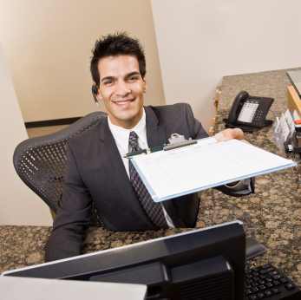
Assist guests with pre-departure & on-departure services
When booking accommodation for departing VIP guest:
Obtain necessary details for the reservation
Use common sense
Check with guest
Book into a similar property
Get Management advice.
Notes:
Trainer explains trainees must capture all necessary details before making, or attempting to make, an accommodation booking – see Class Activity (below).
Trainer also advises trainees they should:
Use common sense when making reservations. There are obviously some venues in some locations which are blatantly inappropriate
Check with guest: Do they have a preference for a venue? A chain? A part of town? Facilities? Views?
When unsure, always book the guest into a property similar to the one they are leaving. Try to match star ratings, facilities, in-room services, cost, relative location to the beach, to the Central Business District, or to the airport).
Class Activity – General Question
Trainer asks the trainee group to identify details a valet should find out about before making a reservation on behalf of a departing valet-serviced guest.
Possible answers include:
Location – the town/city where they require the accommodation
Preferences for a specific venue. Many guests are repeat guests and prefer to stay at a venue they already know and have stayed in before
Dates – identifying ETA and ETD: the number of nights should also be identified to double-check arrival and departure dates
Room type. Never assume:
The guest will always want the best room/suite
Valet service will be required
Numbers relating to:
Number of rooms required
Number of guests – and names
Which guests will, where applicable, stay in the same room/s
Guest details. This may be the business details of the guest and/or their personal details so that:
Pre-registration can occur
Accounts can be established
Guest history can be accessed
Method of payment can be identified
Special requests relating to anything the guest wishes to arrange, and/or their personal needs or preferences.

Slide 135

Assist guests with pre-departure & on-departure services
Guests may require ‘general advice’ when departing:
Weather & travel times
Legal requirements – immigration & customs
Taxes
Transfers
Information about the country to
be visited.
Notes:
Trainer highlights to trainees that they can always expect to be called on to provide ‘general assistance’ when a guest is preparing to depart the venue, especially when they are leaving the country, explaining the information they may require can relate to:
Weather – at their destination, and en route
Travel times – to stop-overs and final destination
Legally required regulations and requirements – relating to complying with and clearing immigration and customs
Taxes – such as entry and departure taxes, and recovering taxes paid while staying in the host country
Organising transfers – movement of the guest and their luggage to airports, dockside or terminals
Customs, language and details about the country they are about to visit.
Class Activity – Small Group Exercise
Trainer divides trainees into small groups and allocates each group a nearby (or neighbouring) country.
Each group is then asked to develop (using internet research, personal knowledge and/or literature research) detailed information on the following topics:
Language spoken
Size of the country
Major towns
Major attractions
Seasonal weather
Local customs
Major festivals and events
Travel time to the country using a variety of common travel options
Other topics as identified by trainer, or identified by trainees.

Slide 136
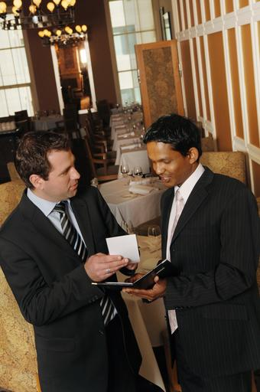
Assist guests with pre-departure & on-departure services
If asked a question you do not know the answer to:
Apologise for not knowing
Capture details of what guest wants to know
Advise the guest you will make enquiries
Do so
Report back to the guest.
Notes:
Trainer explains to trainees where they do not know the answer to queries raised by the guest they should:
Apologise for not knowing
Capture details of what the guest wants to find out about – write down what is required
Advise the guest you will make enquiries and do so:
Ask Management
Involve the Concierge
Undertake internet research
Telephone providers
Read relevant documentation.
It is never acceptable to say “I do not know” and leave it at that.
Report back to the guest with your findings.
Class Activity – Guest Speaker
Trainer arranges for experienced valet to attend class and talk to trainees about:
Their experiences as a valet
Venue and guest expectations about valet service
Dealing with valet-serviced guest requests giving examples of requests they have dealt with
Examples of the ways in which their workplace delivers VIP treatment and services to valet-serviced guests
Examples of how normal or standard service delivery has been varied to suit individual VIP guest requirements or preferences
Ways in which they optimise guest privacy and confidentiality
Tasks involved in facilitating a smooth departure for valet serviced guests.

Slide 137
Summary – Element 3
When delivering valet services:
Be present to meet & greet the guest & their party
Establish a rapport/relationship from the start
Advise guest of your role & what you are
available to do for them
(Continued)
Notes:
Trainer provides a recap of the Element asking questions to check trainee understanding and responding to questions from trainees, as required.

Slide 138
Summary – Element 3
Inform guest of services (and products) available to suit their identified & anticipated needs
Arrange & monitor the movement of luggage to guest room
Unpack guest luggage under direction from
guest – or using initiative & common sense
(Continued)
Notes:
Trainer provides a recap of the Element asking questions to check trainee understanding and responding to questions from trainees, as required.

Slide 139
Summary – Element 3
Clean, check & store guest luggage appropriately
Maintain & monitor guest security (personal & property) at all times
Be sensitive to the need for guests to do
things themselves and/or to be left alone
(Continued)
Notes:
Trainer provides a recap of the Element asking questions to check trainee understanding and responding to questions from trainees, as required.

Slide 140
Summary – Element 3
Prepare guest clothing for guests as directed and/or in accordance with accepted standards & protocols
Press guest clothes where required or arrange for same
Perform basic repairs and/or organise
for repairs to guest clothing
(Continued)
Notes:
Trainer provides a recap of the Element asking questions to check trainee understanding and responding to questions from trainees, as required.

Slide 141
Summary – Element 3
Arrange for laundering and/or dry cleaning as required
Clean/polish & prepare guest shoes as necessary
Purchase clothing & personal items as required
for guest
Deal effectively with guest requests
ensuring no laws are broken & personal
safety is not compromised
(Continued)
Notes:
Trainer provides a recap of the Element asking questions to check trainee understanding and responding to questions from trainees, as required.

Slide 142
Summary – Element 3
Make reservations on behalf of the guest as requested
Arrange for in-room & in-venue service delivery as required
Ensure guest receives VIP treatment
according to venue policies & individual
guest requirements
(Continued)
Notes:
Trainer provides a recap of the Element asking questions to check trainee understanding and responding to questions from trainees, as required.

Slide 143
Summary – Element 3
Modify all service delivery to suit notified or obvious guest needs or preferences
Maintain guest privacy & confidentiality while they are at the venue & after they have departed
Provide departure services such as packing, forward bookings, facilitation of
account luggage movement &
(where applicable) transfers.
Notes:
Trainer provides a recap of the Element asking questions to check trainee understanding and responding to questions from trainees, as required.

Slide 144
Record valet services
Performance Criteria for this Element are:
Process billable charges
Update guest history details
Debrief with management.
Notes:
Trainer identifies for trainees the Performance Criteria for this Element, as listed on the slide.
Class Activity – Discussion
Trainer asks trainees questions regarding activities associated with providing valet services asking questions such as:
What are billable charges?
What involvement might a valet have in processing them?
Why do you think it is important to update guest histories following or as part of a guest stay?
Why do most venues conduct a de-briefing between valets and management following the departure of a valet-serviced guest?

Slide 145
Process billable charges
Billable charges = any charges incurred by the guest that can be legitimately recovered from them.
These charges may be recovered:
Periodically:
At nominated times
When account reaches a nominated
total
When guest departs.
Notes:
Trainer advises trainees that, in order for the venue to recoup money from the guest, the valet is required to process billable charges. “Billable charges’ are any charges incurred by the guest while at the venue that can be legally, legitimately and ethically recovered from them. See below for examples of what these might be.
Trainer identifies to trainees billable charges may be recovered:
Periodically:
Where the guest has an extended stay at the venue, management may require the guest to settle their account every, say, seven days in full
The venue may have a policy (which will have been communicated to the guest when they made their reservation) requiring the guest to settle their account whenever it reaches a nominated total
When the guest departs as part of the check-out process, or by obtaining payment within a prescribed number of days (say, 14 days) after the guest has departed.

Slide 146
Process billable charges
When processing billable charges:
Follow all venue SOPs
All legitimate charges must be processed
Ensure presence of supporting documentation
Processing must be done promptly:
Notify Front Office
Provide guest name & room number
Supply supporting paperwork.
Notes:
Trainer describes to trainees what is involved in processing billable charges:
All house policies and procedures must be followed. These may vary depending on the system used for billing the guest and producing their account
All legitimate charges must be processed by the valet – no exceptions. If the guest is to be granted an exemption for a charge (that is, a product or service is to be provided free of charge), then management should make this decision.
All billable charges must be supported by appropriate documentation. This paperwork explains and describes the charge, and may contain a signature as evidence of the legitimacy of the charge. Documentation may be a receipt or a docket.
All charges must be processed promptly. The standard requirement is to process charges as they occur. Some internal systems enable automatic posting of charges to accounts as they occur from linked point-of-sale terminals/registers.
From the valet’s point of view, processing a billable charge means:
Notifying Front office of the charge
Advising of the room number and guest name
Forwarding supporting documentation.
When Front Office has been notified they will update the guest account by posting the charge to the guest account.

Slide 147
Process billable charges
Examples of billable charges:
Room service charges
Disbursements
Meals & drinks
Functions & parties
(Continue)
Notes:
Trainer provides trainees with examples of billable charges explaining, in practice, there is no limit as to what may be charged to a guest’s account:
Room service charges – for in-room meals, snacks, and drinks
Disbursements – any monies paid out by the venue on behalf of the guest will need to be recovered
Meals and drinks – from venue bars, cafes, dining rooms, restaurants or similar
Functions and parties – these can include smaller in-room events as well as larger functions conducted in function rooms.

Slide 148
Process billable charges
Mini bar use
Retail items
Extra services – personal, business, travel, laundry
Repairs, maintenance & cleaning.
Notes:
Trainer continues to give trainees examples of billable charges:
Mini bar use. Guests may be required to pay for items used from the mini bar but some VIP guests may have free access to all mini bar items (with the cost of these items built into the room charge). Check with management to see what applies in your venue. The fact is the requirement in this regard can vary with the individual guest. For example, a high-roller in a ‘comp’ suite (complimentary, free-of-charge room) will not be required to pay for their use of the mini bar (or some other charges normally applied to other guests). In many venues a dedicated staff member may be responsible for re-stocking the mini bar and processing any charges arising.
Retail items where the venue has retail shops/outlets, purchases such as merchandise and souvenirs may also need to be charged or processed
Extra services. These can include:
Personal services – baby-sitting, massage
Business services – photocopying, interpreter and secretarial services
Transport, travel and tours
Laundry and dry cleaning
Repairs, maintenance and cleaning. Where the guest has caused deliberate damage to venue property (apart from ’fair wear and tear’) the property will usually seek to recover costs required to effect necessary repairs or cleaning. Depending on the guest and the circumstances, management may seek to recover such costs even where the damage was accidentally caused.
Class Activity – Guest Speaker
Trainer arranges for a Manager or Front Office staff member from a venue offering valet service to attend and speak to trainees about:
When billable charges are recovered identifying frequency and/or maximum amounts guests are allowed to charge to their account
How guests are advised their account requires settlement
Standard protocols and requirements applying to valets regarding the processing of billable charges
Examples of supporting documentation and its importance in billing guests
Timelines applying to processing billable charges
Examples of billable charges.

Slide 149

Update guest history details
‘Guest history’:
A valuable source of guest information
Enables more effective guest room preparation
May be paper-based or electronic
Must be updated for every guest stay:
  Before guest arrival
  During guest stay
  After guest has departed.
Notes:
Trainer reminds trainees the ‘guest history’ provides a valuable source of information about guests and needs to be updated whenever a guest stays at a venue advising trainees:
Enables proper preparation for guest stays – and more customer-focussed preparation leading to a more satisfying and positive guest experience
Guest histories can be in paper-based format (using cards), or electronic format using a CRS database
Can need to be updated:
Before the guest arrives on the basis of information provided as part of the reservation (by the guest themselves or by their agent, manager or support staff)
During the guest stay as the guest uses products, services and facilities, and participates in local activities
After the guest has departed and all information relating to their stay has been compiled.

Slide 150

Update guest history details
Information from venue staff & external providers should be included in guest history updates:
Details of products & services provided, used or requested
Facilities used
Personal preferences:
Room number/s; seating; external
providers; food & beverages;
packing of luggage
(Continued)
Notes:
Trainer instructs trainees the updating of guest histories should involve input from internal, venue staff as well as input from external providers and can address:
Products and services provided – updates can require:
Time of use
Cost
Quantity
Preferences for types, styles, brand names of items, service style, sequence of delivery
Facilities used – identifying:
What was used – and when
Charges made – if any
Amount of use
Personal preferences – in addition to the above, the guest history should be updated to reflect current/required:
Room number preferences – some VIP guests insist/specify a certain room every time they stay
Seating preferences – for dining or entertainment
External product and/or service providers – naming the organisations the guest prefers to do business with when dealing outside the venue
Food and drinks – detailing preferences for:
Menu items
Cocktails
Service
Serve size
Brand names
Special requests – for sauces, ice, cutlery, glassware
Packing of cases and bags on departure – identifying, if applicable:
Clothing folds – for shirts, trousers, dresses
Separation and segregation of items
Preferences for how and where items are packed

Slide 151
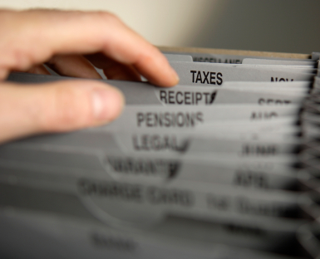
Update guest history details
Attractions visited & events attended
Timing details for service delivery
Special occurrences impacting the guest & their stay.
Notes:
Trainer continues to present to trainees the guest history information that may need to be updated for a valet-serviced guest:
Tourist attractions visited and events attended including:
Dates
Time at each attraction/event
Transportation used
Activities undertaken and experiences
Timing details. It is common to record:
Arrival time – at the venue
Departure time – on departure
Dining times – all meals
Wake-up calls
Flight/travel time preferences
Special occurrences – there is always a need to capture details in relation to:
Problems experienced – describing what happened, who was involved and how the situation was resolved
Complaints – indicating cause of the complaint and the resolution as well as details of the investigation and causal factors identified
Unusual circumstances. This may include details relating to theft of guest property, confusion over the account (such as items charged to the account, deposits paid, progress payments or final account settlement), any occurrence where internal Security staff were involved or external authorities had to be contacted (assaults, violence, fighting).
Class Activity – Guest History: Excursion or In-class Activity
Trainer arranges for trainees to view a computerised Guest History system and:
Note the fields available within the system for Guest History
Observe trainer (or venue staff) operate the system and update a guest history
Discuss factors/information that can be changed
Practice inputting information, if possible.

Slide 152

Debrief with management
Management meet with valets after a valet-serviced guest has departed to:
Review the guest experience
Address issues arising
Determine if policies and/or procedures need to change
Other venue staff may also be
involved in the debriefing.
Notes:
Trainer informs trainees it is standard operating procedure in most venues for management to hold a debriefing session with the valet when a valet-serviced guest has departed explaining these are undertaken to:
Gain an insight into the experience the guest had while at the venue. The valet is arguable in the best position to provide information on this topic given the close relationship existing between valet and guest
Address issues arising or unresolved when the guest departed. Management may wish to contact the guest to resolve issues, apologise or make some other appropriate offer or gesture
Determine whether existing policies and procedures need changing to better meet identified needs, wants and preferences of the guests on the basis of very recent feedback and/or observations
Management may elect to include other venue staff in this debriefing:
Security
Food and beverage staff – bar staff, waiters
Chefs
Room attendants
Porters
Concierge.

Slide 153
Debrief with management
Topics for discussion at the de-briefing:
Complaints – causes, impact & resolutions
Compliments – what & who was involved
Products & services – good & bad; changes needed
Suggestions & recommendations – service
delivery, new or changed products
and new markets.
Notes:
Trainer identifies to trainees the topics that may be discussed when valets debrief with management following a valet-serviced guest stay indicating there is no limit to what may be discussed:
Complaints addressing:
What caused them
How they were resolved – if applicable
Impact on the guest and their stay
Compliments – identifying:
The product, service or staff member/s giving rise to same
Any action taken to notify relevant persons of the compliment
Products and services – identifying issues needing to be addressed regarding the delivery of services and/or the provision of products to guests highlighting:
Changes needing to be considered
Outstanding or very good products or instances of service delivery
Inappropriate or negative products or instances of service delivery
Suggestions – as they apply to:
Recommendations for revisions to existing protocols. This can apply to all aspects of a guest’s stay including:
Pre-arrival activities
Registration and check-in
Delivery of services
Contact with and use of external providers
Account presentation and settlement
Pre-departure and on-departure activities
Recommendations for additions to products, services and facilities available to guests
Identification of emerging niche markets based on feedback from the guest and personal observation, so the venue can capitalise on new opportunities.

Slide 154
Summary – Element 4
When recording valet services:
Ensure all billable charges are processed promptly
Check all legitimate charges are processed
Provide supporting documentation for
all billable charges
(Continued)
Notes:
Trainer provides a recap of the Element asking questions to check trainee understanding and responding to questions from trainees, as required.

Slide 155
Summary – Element 4
Liaise with Front Office regarding processing of billable charges
Follow house policy or individual arrangements for particular guests when facilitating account settlement
(Continued)
Notes:
Trainer provides a recap of the Element asking questions to check trainee understanding and responding to questions from trainees, as required.

Slide 156
Summary – Element 4
Update guest history for every valet-serviced guest stay before, during and after their stay
Communicate with management when VIP guest has departed to identify if necessary action to take in response to issues arising or events
occurring during the guest stay.
Notes:
Trainer provides a recap of the Element asking questions to check trainee understanding and responding to questions from trainees, as required.
Trainer thanks trainees for their attention and encourages them to apply course content as required in their workplace activities.

